Slide 1
STEM Teacher Knowledge in the Common Core Era:
Building the Standards for Mathematical Practice into Professional Development
Kevin McLeod, UW-Milwaukee (Mathematics)
Henry Kepner, UW-Milwaukee (Mathematics Education)
NSF STEM Smart Conference
University of Illinois at Chicago, April 10 2012

Slide 2
Common Core State Standards (CCSS)
State-led initiative, launched by the National Governors Association and Council of Chief State School Officers.
Written by teams of mathematicians, mathematics educators and K-12 school representatives.
Lead authors: Bill McCallum, Jason Zimba, Phil Daro.
Currently adopted by 45 states
Notes:
The intention would be to move quickly through the CCSS background slides—especially if this was covered during the plenary address.

Slide 3
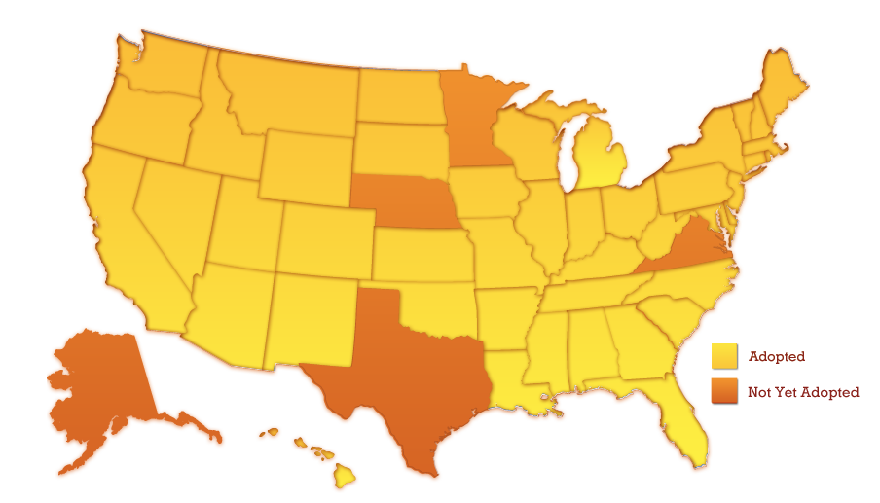
CCSS-M Adoption (as of 04-03-12)
87% of U.S. population

Slide 4
CCSS Overview
K-12 Standards for Mathematical Practice.
K-8 grade-level Standards for Mathematical Content, grouped within clusters within domains.
High school Standards for Mathematical Content, grouped within clusters within domains within conceptual categories.
“The high school standards specify the mathematics that all students should study in order to be college and career ready. Additional mathematics that students should learn in order to take advanced courses such as calculus, advanced statistics, or discrete mathematics is indicated by (+)” (p.57)
Notes:
Ask participants to discuss in small groups for 5-10 minutes, and then come back and discuss/record as a whole group.

Slide 5
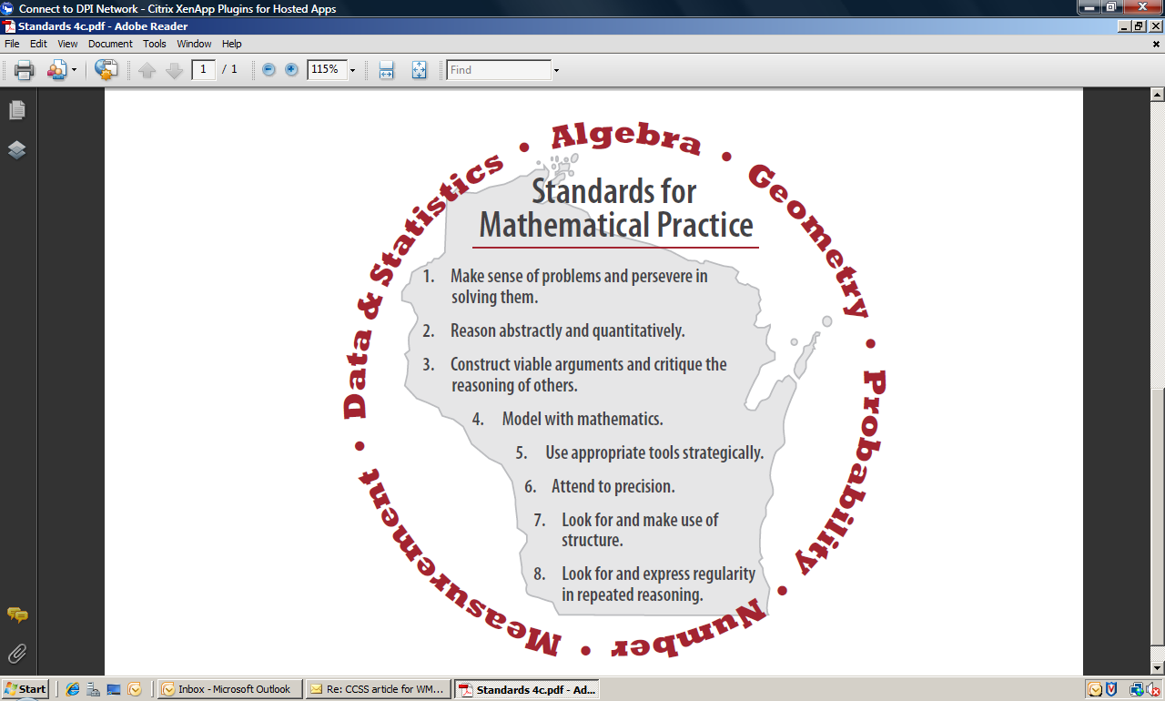
CCSS Standards for Mathematical Practice
Notes:
Make sure to stress that these are not Wisconsin’s version of the Practice Standards—just the Wisconsin logo.

Slide 6
Critical Shifts from Typical State Standards to CCSS-M
CCSS emphasis on “focus, coherence and rigor”
CCSS emphasis on Standards for Mathematical Practice
CCSS emphasis on Modeling
CCSS content is shifted to earlier (usually) or later grade levels
  Later: Statistics and Probability
CCSS emphasizes unit fractions, and fractions as numbers on a number line
CCSS emphasizes transformation approach to geometry

Slide 7
Mathematics Practice Standards and Professional Development
Practice standards cannot be “taught” in isolation, but must be approached through appropriate content tasks
The Milwaukee Mathematics Partnership (MMP) developed 7 seminars for teacher leaders during the 2010-2011 school year, each focusing on understanding one of the Common Core Practice Standards, exemplified through a specific mathematics content task related to a Common Core Content Standard.
Notes:
Announce: we will briefly model the first of these sessions for you (starting with the next slide)

Slide 8

CCSS 101: Standards for Mathematical Practice
MTL Kick-Off
August 26, 2010
Notes:
20 minutes for slides 1-6

Slide 9
Learning Intentions
We are learning to:
recognize the first of the Standards for Mathematical Practice within a chosen Content Standard.
identify those standards within a particular math task.
Notes:
There are 8 Standards for Mathematical Practice. We will focus on the first standard for mathematical practice. The Standards for Mathematical Practice describe varieties of expertise that mathematics educators at all levels should seek to develop in their students. The practices rest on important processes and proficiencies with longstanding importance in mathematics education.
We will identify 2 standards (mathematical practice and content ) within a math task.

Slide 10
Success Criteria
We will know we are successful when we can articulate how both a Content Standard and a Standard for Mathematical Practice are infused in a math lesson in the classroom.
Notes:
In this session, you will be asked to unpack a content standard and a standard for mathematical practice. We will encourage you to critically think about the role of the teacher and students during this learning experience.
eas

Slide 11
Vocabulary
Domain: Functions (8.F)
Cluster: Use functions to model relationships between quantities.
Standard 5: Describe qualitatively the functional relationship between two quantities by analyzing a graph (e.g., where the function is increasing or decreasing, linear or nonlinear). Sketch a graph that exhibits the qualitative features of a function that has been described verbally.
Notes:
In order to effectively read the grade level standards, it is imperative for you to be aware of some vocabulary.
Domains are large groups of related standards (i.e., the number system, expressions and equations, functions, operations and algebraic thinking, number and operations in base ten (3. NBT), measurement and data, geometry, etc.) . Standards from different domains may sometimes be closely related.
Clusters are groups of related standards. Standards from different clusters may sometimes be closely related, because mathematics is a connected subject. You may have one or several clusters under a domain (e.g., the domain: Functions has two clusters: Define, evaluate, and compare functions AND Use functions to model relationships between quantities.)
Standards define what students should understand and be able to do. Under the domain of Functions and under the cluster of (use functions to model relationships between quantities, we are focusing on standard 5.

Slide 12
Unpacking the Content Standard
Individually read Standard 5
? – “I have a question about this.”
* - “This makes sense to me.”
With your group, discuss questions and highlight key ideas in this standard.
Notes:
To describe qualitatively- writing/speaking your interpretation of the relationship of two quantities (numbers). Analyzing and explaining your interpretation of a graph. Draw a graph to support your thinking of the qualitative features (story) of a function that has been described verbally.

Slide 13
Content Standard Discussion
Standard 5: Describe qualitatively the functional relationship between two quantities by analyzing a graph (e.g., where the function is increasing or decreasing, linear or nonlinear). Sketch a graph that exhibits the qualitative features of a function that has been described verbally.
Notes:
Facilitate whole group discussion, one idea from each table, charting optional

Slide 14
Unpacking the Practice Standard
1. Make sense of problems and persevere in solving them.
Individually read the practice standard
? – “I have a question about this.”
* - “This makes sense to me.”
With your group, discuss questions and highlight key ideas in this standard.
Notes:
Read and unpack the Practice Standard. What are the words saying???? This is a K-12 mathematical practice…processes and proficiencies…at the end of the learning experience.
-analyze givens, constraints (the son’s age will never be older than his dad’s age) relationships, and goals (what the problem expects as an answer): KWL, what do I know?
-explaining, plan solution pathway, check their answers to problems using a different method, understand the approaches of others to solving complex problems, monitor and evaluate their progress and change course if necessary, use pictures to help conceptualize and solve a problem, check their answers and ask themselves, “Does this make sense?”

Slide 15
Linking Practice to the Classroom
What would this practice look like in a classroom?
  Students would be…
  Teachers would be…
Notes:
Use think, pair, share; chart using a graphic organizer, e.g. Venn diagram, two column chart in a whole group discussion
Students: explaining to themselves the meaning of a problem, looking for entry points to its solutions, talk about what they know about the problem, talk about what the problem expects for an answer, make conjectures about the solution, plan a solution pathway, consider analogous problems, monitor and evaluate their progress, explain and justify their thinking, draw pictures, ask themselves, “does this make sense?”, understand the approaches of others, and identify correspondences (relationships) between different approaches.
Teachers: invite students to share strategies, present prompts that students have to make sense of the task/questions, strategical (purposeful) use of multiple representations/approaches to the problem, provide manipulatives and resources, students get multiple experiences

Slide 16
Graph a Story
Notes:
Refer to learning intention prior to the task. Monitor the groups as the facilitator focusing on making sense of problems and persevering. Give time for individuals to work on the problem. Discuss graphs of group; show 2-3 examples of graphs looking at a range of answers.

Slide 17
What did we see?
What did you as students do to bring the standards alive?
What did the facilitator as a teacher do to bring the standards alive?
What else might you as teachers in your classroom do to bring the standards alive?
Notes:
Chart responses
Students: be able to articulate the big mathematical ideas embedded in the standard in student-friendly language, explaining to themselves the meaning of a problem, looking for entry points to its solutions, talk about what they know about the problem, talk about what the problem expects for an answer, make conjectures about the solution, plan a solution pathway, consider analogous problems, monitor and evaluate their progress, explain and justify their thinking, draw pictures, ask themselves, “does this make sense?”, understand the approaches of others, and identify correspondences (relationships) between different approaches.
Facilitator/Teacher: clarify the big mathematical ideas embedded in the content standard, invite participants to unpack mathematical practice to determine the learning experience/exposure for students in the classroom, engage participants in a discussion of what the teacher should expect/look for in the classroom.
Demonstrated the math practice coming alive during the teaching experience. Linked the practices to the classroom.
Other things to do: engage students to share strategies, present prompts that students have to make sense of the task/questions, strategical (purposeful) use of multiple representations/approaches to the problem, provide manipulatives and resources, students get multiple experiences

Slide 18
Summary
We are learning to recognize the first of the Standards for Mathematical Practice within a chosen Content Standard and identify those standards within a particular math task.
We will know we are successful when we can articulate how both a Content Standard and a Standard for Mathematical Practice are infused in a math lesson in the classroom.

Slide 19
More Information
Milwaukee Mathematics Partnership website: mmp.uwm.edu
MMP Professional Development (2010-2011): http:// www4.uwm.edu/Org/mmp/_resources/MTLsubpg/Yr8/MTLpageYr8.html
Common Core State Standards:
www.corestandards.org
Bill McCallum’s blog:
commoncoretools.me

