Slide 1
Engineer Your World
UTeachEngineering
The University of Texas at Austin
Cheryl Farmer, Project Director
Lisa Guerra, NASA Research Fellow

Slide 2
Presentation Overview
What is UTeachEngineering?
Overview
Texas Pilot and Early Results
Pilot Phase Two
2014 and Beyond

Slide 3
Presentation Overview
What is UTeachEngineering?
Overview
Texas Pilot and Early Results
Pilot Phase Two
2014 and Beyond

Slide 4




What is UTeachEngineering?
Funded by the National Science Foundation (NSF) through a $12.5M grant from the Math-Science Partnership (MSP) program
Grant period of performance: 2008-2013
One of three NSF MSP grants focusing on K-12 engineering education
A unique partnership designed to
  (Short-term) Respond to the current opportunity in Texas (4x4 requirement)
  (Long-term) Develop and evaluate a model for addressing national engineering needs
+
+

Slide 5
What is UTeachEngineering?
A model high school engineering course and supporting professional development
Teacher preparation – degree programs
  In-Service: Master of Arts in Science and Engineering Education (MASEE)
  Pre-Service: BS programs for STEM majors pursuing teaching certification
Meaningful research in an emerging field

Slide 6
Presentation Overview
What is UTeachEngineering?
Overview
Texas Pilot and Early Results
Pilot Phase Two
2014 and Beyond

Slide 7

Features
Engages students in authentic engineering practices
Project-based environment
  80% hands-on activity
  20% documenting and reflecting on work, preparing presentations and reports, participating in direct instruction
Actively engages students in engineering practices (p 18)

Slide 8
Features
Student learning scaffolded over six design challenges
  Standardized engineering design process
  Requires purposeful application of engineering
  principles and relevant science and math concepts
Aligned with Texas state standards and emerging Next Generation Science Standards
Deepen understanding of concepts shared across STEM (p 19)
Coherent set of standards and curriculum (p 19)

Slide 9
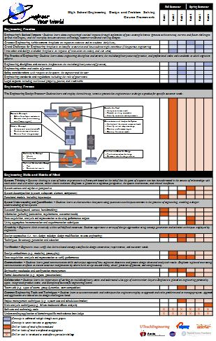
Course Framework

Slide 10
Course Framework
Student Learning Outcomes
Engineering design projects related to core ideas in the discipline (p 19)

Slide 11
Course Framework
Engineering Design Process
Engineering design projects related to core ideas in the discipline (p 19)

Slide 12
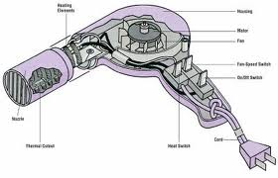
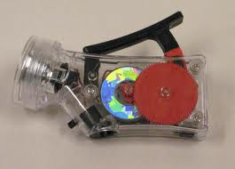
Active engagement (p 18) Related to core ideas (p 19)
Unit 1: Reverse Engineer Your World
Engineering impacts our everyday lives.
Functional models
Research
Information gathering
Reverse engineering

Slide 13
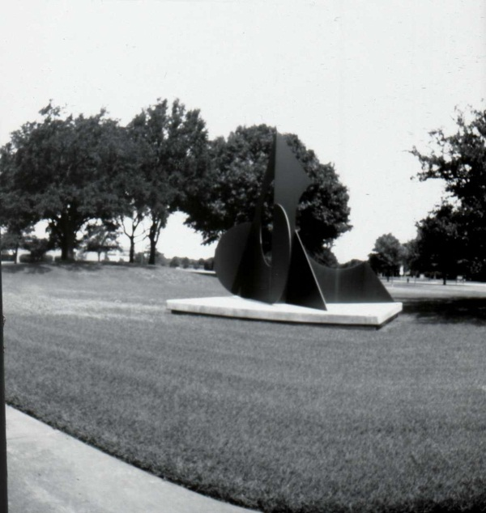
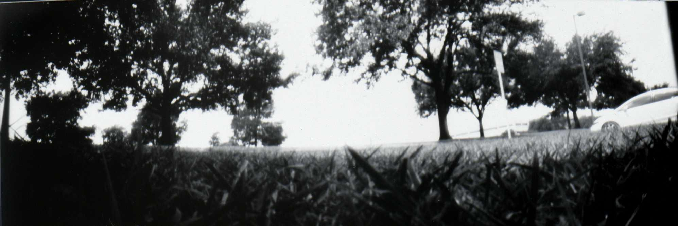
Active engagement (p 18) Related to core ideas (p 19)
Unit 2: The Evolution of Imagery
Engineers design products to satisfy customer wants and needs.
The engineering design process
New design
Design evolution
Design embodiment
Performance verification
Engineering notebooks

Slide 14
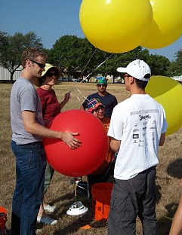
Active engagement (p 18) Related to core ideas (p 19)
Unit 3: Aerial Imaging
Engineers work in teams to solve complex design challenges.
Teamwork
Project management
System decomposition
Design at the subsystem level
Requirements
Concept generation and selection
Ethics and safety

Slide 15
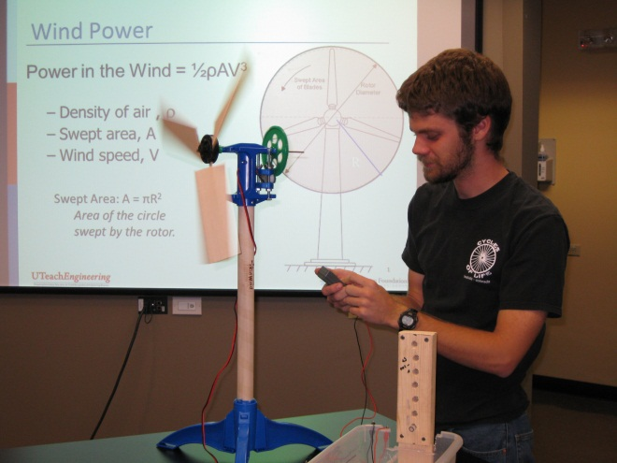
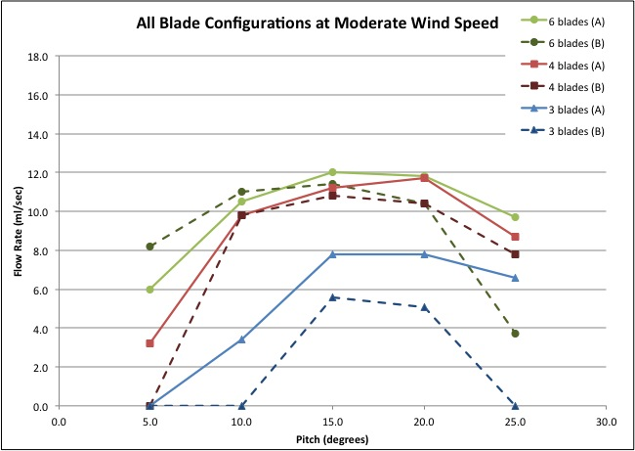
Active engagement (p 18) Related to core ideas (p 19)
Unit 4: Green Energy for Clean Water
Engineers improve lives.
System context and top-down perspective
Developing performance targets
Appropriate instrumentation
Design modification
Performance verification
Formal documentation
Greatest engineering achievements

Slide 16
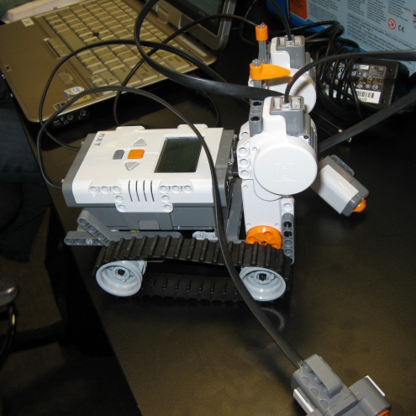
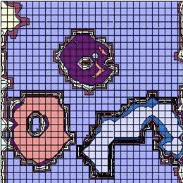
Active engagement (p 18) Related to core ideas (p 19)
Unit 5: The Search for Lunar Ice
Engineering opens frontiers.
Automation and control
Programming basics
Operations planning
Engineering’s grand challenges

Slide 17
Active engagement (p 18) Related to core ideas (p 19)
Unit 6: Culminating Design Challenge
Engineers in all disciplines solve open-ended design challenges.
More complex unit; less structured
Student-directed design process
Includes all engineering critical aspects
Focuses on STEM professions
Introduces risk analysis
Introduces project management skills

Slide 18
Presentation Overview
What is UTeachEngineering?
Overview
Texas Pilot and Early Results
Pilot Phase Two
2014 and Beyond

Slide 19
2011-12 Pilot Districts
Number of Students

Slide 20
2011-12 Pilot Schools
Number of Students
Acceptable

Slide 21

Pilot Teachers
Campus (Rating) | # Sections Offered | # Students in 2011-12 Pilot Course | Other Courses Taught | Years Teaching Experience | Engineering Degree or Experience
Bowie HS (R) | 1 | 24 | Physics | 20 | No
Crockett HS (A) | 1 | 9 | Physics | 15 | No
McCallum HS (A) | 1 | 10 | CAD | 10 | No
Reagan HS (A) | 1 | 7 | Physics | 4
Dripping Springs HS (R) | 1 | 22 | Statistics | 10
Plano HS (R) | 4 (2 teachers) | > 120 | Physics | 5 and 2
Stony Point HS (A) | 2 | 60 | Physics | 16 | No

Slide 22
Early Results from 2011-12 Pilot
Teachers struggled to complete the course in their first year (to be expected)
  Generally completed 80-85% of the course (Units 1-5)
  Should be able to cover more as materials become familiar
Need to establish classroom norms early in the course
  General norms
  Engineering norms (collaboration, communication)
Need to modify and strengthen scaffolding
  Reorder introduction of certain skills
  Reinforce key concepts consistently across units

Slide 23
Presentation Overview
What is UTeachEngineering?
Overview
Texas Pilot and Early Results
Pilot Phase Two
2014 and Beyond

Slide 24
Teacher Professional Development
Two-week workshop to enhance participants’ engineering content knowledge and pedagogical content knowledge
Features:
  Content aligned to course and underlying standards
  Appropriate for teachers from diverse backgrounds
  Emphasizes active engagement and problem-solving
  Conveys clear ideas about effective teaching and learning
  Offers frequent opportunities for
  critical reflection on teaching
Teachers’ capabilities and knowledge to teach content and subject matter (p 21)
Addresses teachers’ classroom work (p 21)

Slide 25
Mentor Program for Teachers
Developing and testing mentorship model for scale
  Mentor PD in conjunction with teacher PD
  Ongoing SIG for participants
In-person engineer mentors for teachers from
  NASA space flight centers
  NASA affiliates (e.g., Washington Museum of Flight, Colorado’s Shades of Blue)
Benefits to teacher and students
  Support teacher in first year, assist with “tough” spots
  Offer classroom visits and additional resource (e.g., facility tours, access to industry/government design challenges)

Slide 26
Developing Validated Assessments
Rubrics for assessing student performance
Rubrics for assessing student artifacts
  Major focus in 2012-13
  Internal and external experts
  Develop rubrics
  Assure inter-rater agreement among experts
  Pilot with teachers
Supportive system of assessment - internal to course (p 21)

Slide 27
Presentation Overview
What is UTeachEngineering?
Overview
Texas Pilot and Early Results
Pilot Phase Two
2014 and Beyond

Slide 28
Enhancement and Expansion
Advanced Placement (AP) Option
  Current portfolio option aligned to draft AP requirements
  Anticipated for credit in 2014-15
Expanding Network
  NASA’s Space Grant Consortium
  NSTA Regional Meetings — Engineering Days
  State Departments of Education

Slide 29
Developing Courseware:
LMS + Virtual Collaboration Tool
M₁ |  |  |  | M₂ |  |  | … | M_{X}
T₁ |  |  |  | T₂ |  |  | … | T_{X}
S₁₁ | … | S_{1N1} |  | S₂₁ | … | S_{2N2} | … | S_{X1} | … | S_{XNX}
Mentor/mentor collaboration
Teacher/mentor collaboration
Teacher/teacher collaboration
Teacher-student communication
Student/student collaboration

Slide 30
Developing Courseware:
LMS + Virtual Collaboration Tool
For teachers, access to
Course Materials
  Lesson plans
  Background materials
  Supporting resources
Ongoing PD
  Refresher videos
  On-time training
  Webinars on practice
Course Management Tools
  Share resources with students
  Assign, view, assess student work
Collaboration Tools
  Teacher-to-teacher
  Teacher-to-mentor
M₁ |  |  |  | M₂ |  |  | … | M_{X}
T₁ |  |  |  | T₂ |  |  | … | T_{X}
S₁₁ | … | S_{1N1} |  | S₂₁ | … | S_{2N2} | … | S_{X1} | … | S_{XNX}
Multiple and sustained opportunities for teacher learning over time (p 21)
Interaction and collaboration with colleagues (p 21)

Slide 31
Developing Courseware:
LMS + Virtual Collaboration Tool
M₁ |  |  |  | M₂ |  |  | … | M_{X}
T₁ |  |  |  | T₂ |  |  | … | T_{X}
S₁₁ | … | S_{1N1} |  | S₂₁ | … | S_{2N2} | … | S_{X1} | … | S_{XNX}
For mentors, access to
Course Materials
  Lesson plans
  Background materials
  Supporting resources
Teacher PD Materials
  Refresher videos
  On-time training
Collaboration Tools
  Mentor-to-mentor
  Mentor-to-teacher

Slide 32
Developing Courseware:
LMS + Virtual Collaboration Tool
M₁ |  |  |  | M₂ |  |  | … | M_{X}
T₁ |  |  |  | T₂ |  |  | … | T_{X}
S₁₁ | … | S_{1N1} |  | S₂₁ | … | S_{2N2} | … | S_{X1} | … | S_{XNX}
For students, access to
Course Materials
  Background materials and supporting resources shared by teacher
  Assignments
Virtual Engineering Notebook
  Document work for self
  Submit work to teacher
  Prepare portfolio for AP or admissions
Collaboration Tools
  Student-to-student
  Student-to-teacher

Slide 33
Presentation Overview
What is UTeachEngineering?
Overview
Texas Pilot and Early Results
Pilot Phase Two
2014 and Beyond
cheryl.farmer@mail.utexas.edu
512-471-6196
www.engineeryourworld.org
www.uteachengineering.org

Slide 34
Backup Slides
Why Teach Engineering?
Why Now?

Slide 35
The National STEM Conversation is
Happening Now
Rising Above the Gathering Storm, Revisited: Rapidly Approaching Category 5 (9/2010)
Report to the President – Prepare and Inspire: K-12 Education in STEM for America’s Future (9/2010)
Change the Equation, a CEO-led initiative to cultivate widespread STEM literacy (9/2010)
Notes:
Released by the National Academies, September 2010 (http://www.nap.edu/catalog/12999.html)
2005 – RAGS:
an impending shortage of scientists, engineers, and technical personnel at least partly caused by inadequate K-12 science education threatens the nation’s long-standing scientific leadership in an increasingly competitive, globalized world
called for more undergraduate and graduate science scholarships, new programs to train science teachers, more research funding, and more foreign scientists to be admitted to this country
2010 – RAGS, Revisited:
The situation has gotten worse, not better
***********************
Released by the President’s Council of Advisors on Science and Technology (PCAST), September 2010 (http://www.whitehouse.gov/sites/default/files/microsites/ostp/pcast-stemed-report.pdf)
An advisory group of the nation’s leading scientists and engineers produced a report that provides a strategy for improving K-12 STEM education:
prepare students so they have a strong foundation in STEM subjects and are able to use this knowledge in their personal and professional lives
inspire students so that all are motivated to study STEM subjects in school and many are excited about the prospect of having careers in STEM fields
***********************
Launched by President Obama, September 16, 2010 (http://www.changetheequation.org/)
Through its network of 110 CEOs, Change the Equation pledges to create widespread literacy in science, technology, engineering and math (STEM) as an investment in our nation.
It works toward three critical goals:
Great Teaching. Improve STEM teaching at all grade levels, with a larger and more diverse cadre of highly capable and inspirational STEM teachers.
Inspired Learners. Inspire student appreciation and excitement for STEM programs and careers to increase success and achievement in school and opportunities for a collegiate education, especially among females and students of color.
A Committed Nation. Achieve a sustained commitment to improving STEM education from business leaders, government officials, STEM educators and other stakeholders through innovation, communication, collaboration and data-based decision making.

Slide 36



National Policy Picture
In the national STEM conversation, what is the role of engineering? How can engineering be more than the “silent E” in “STEM”?
Engineering in K-12 Education
National Academy of Engineering (NAE), 2009
Standards for K-12 Engineering Education?
NAE, 2010
Integrating engineering standards;
to be reviewed & released, 2012

Slide 37
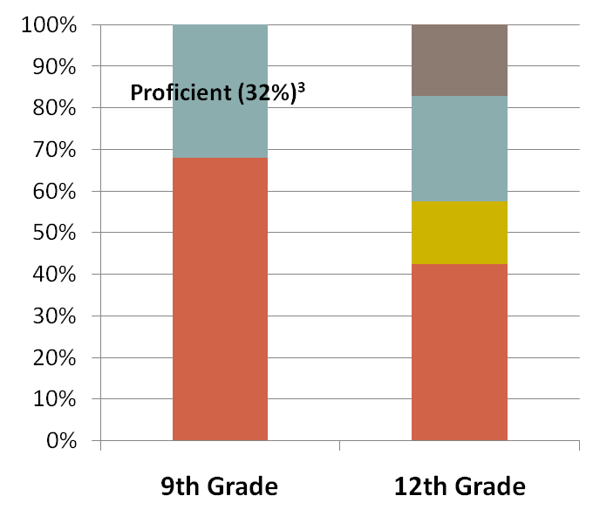
National Need
7% of HS freshmen
Proficient ,
Interested (17%) ²
STEM Major
Graduate with STEM Major
Proficient,
Not Interested (25%) ²
Not Proficient ,
Interested (15%) ²
Non-STEM Major
4% of HS freshmen
Not Proficient ,
Not Interested (42%) ²
Not
Proficient (68%) ³
2-Year College
College Grad
Career
278,000
STEM majors of 1,170,000 enrolled in 4-year college¹
167,000
STEM graduates expected in 2011¹
4,013,000
beginning 9th grade in 2001¹
2,799,000
graduates in class of 2005¹
Sources: (1) Gates Foundation, NCES Department of Education Statistics; Science and Engineering Indicators 2008.
(2) BHEF U. S. STEM Education Model, February 2010. Based on ACT’s “College Ready” definition, which is different from NAEP proficiency.
(3) NAEP Mathematics 2009 national results, grade 8.

Slide 38
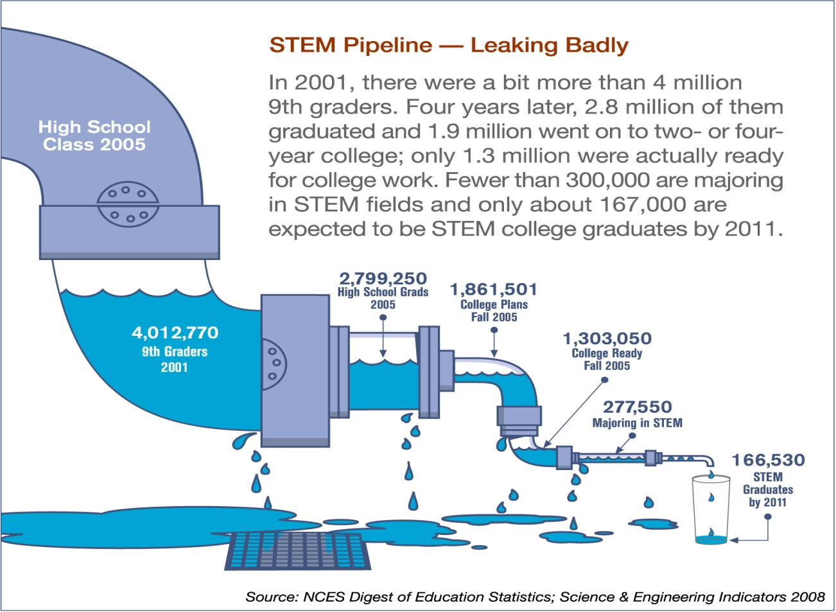
National Need

