Slide 1
Why Are Educational Policies Developed and
Refined Over 25 Years Not Working Well?
David Grissmer
Center for Advanced Research on Teaching and Learning
Curry School of Education
University of Virginia
Notes:
Something fundamental that we are missing in our educational policies
These policies have not produced the results that many of us expected
The policies cannot explain some of the success we have had
Some fundamental disconnect between our policies and results
New research in developmental science and neuroscience is suggesting that the assumptions
that underlie these policies about the way children learn may be flawed

Slide 2
Something Fundamental May Be Missing in our Educational Policies
These policies have not produced the expected results
The policies cannot explain some of the success we have had
New research in developmental science and neuroscience is challenging certain assumptions that underlie these policies
  Skills needed in later math are all learned in direct instruction in early math
  Schools and teachers are the problem and improving their productivity is the answer

Slide 3
Topics
The Puzzling Results of Current Education Policies
New Theory and Evidence That May Help Explain These Results
  What measures known at kindergarten entrance explains 8th grade achievement ?
  Experimental evidence- Minds in Motion(MIM)
New Directions for Policy
Notes:
Current education policies--- What does this mean

Slide 4
Question 1- True or False
National 4th and 8th grade math and reading scores have shown little gain in the last 20 years.
Reading scores have made bigger gains than math scores.
Black students have made almost no gains in achievement over the last 20 years
Achievement gaps between black and white students have increased

Slide 5
Very Large Math Gains Have Occurred, but Reading Gains Have Stagnated
(NAEP-1992-2009)
Notes:
What has our policies bought
Very large gains in 4th and 8th math- example 50th to 30th percentile
No general theory on why the difference in reading and math exist
Most policies would be expected to raise both- class size, pre-K, improving teachers,
Accountability emphasis- if anything we had much more emphasis on reading than math in this time period
So surprise that math outpaces reading so much
Question- are these gains only for higher or lower scoring students?

Slide 6
Substantial Achievement Score Gaps Exist Between White/Asian Students Not Eligible for Free Lunch and All Other Racial/Ethnic Groups
8th Grade NAEP Math Scores
Notes:
Go through it first carefully
Only one group is doing well- scoring above U.S average
Remaining groups have very large gaps
50% of population in each- half doing well internationally
Path to higher internatinal scores lies in closing score gaps uin U.S
No other nation has such large gaps between substantial parts of the population- unique to U.S.

Slide 7
All Racial/Ethnic Groups Made Large Math Gains, but Black and Hispanic Gains Were Larger Than White Gains
(NAEP-1992-2009)
Notes:
Thses gains werw spread across all racial/ethnic group and hgh and low scoring students
Both made substantial gains- a black student made 30 percentile point gains
How widely known is it that black student math gains were among the highest in the country
Schools produced these gains---------------

Slide 8
All Racial/Ethnic Groups Made Small Reading Gains, but Black and Hispanic Gains Were Larger Than White Gains
(NAEP-1992-2009)
Notes:
Minority students outpaced white studebt gains in reading as well0- but gains were small

Slide 9
Achievement Gaps Have Narrowed in All Grades and Subjects With Larger Gap Reductions at 4th Grade and in Math, but Substantial Gaps Remain
(NAEP-1992-2009)
BLACK
HISPANIC
Notes:
This is what improving schools with Drill and Kill has produced- high math gains, little reading gains and a little progresss on score gaps---- conclusin- schools may not be the primary way to close score gaps

Slide 10
Puzzling Questions
What caused the large math score gains for all groups of students ?
Why didn’t reading scores make similar gains?
Why didn’t the policies that caused the large math gains also narrow achievement gaps more?
Why have achievement gaps narrowed by only small amounts since 1985- despite substantial national and state and local effort?
Can some assumptions underlying the educational policies over the last 25 years be wrong?
Notes:
Where are the teachers who got us the very large 4th grade math gains!! Stand up- hurray
But boo to the teachers who got us the small reading gains- it’s the same teachers!!!

Slide 11
Current Education Policies Since Late 1980’s (Plan A)
Standard’s based accountability for schools and teachers
Emphasis on reading and math as foundational
  Start direct instruction earlier
  Spend more time on instruction
  Do intense remediation for lower scoring students
  Improve quality of teachers and curriculum
School and teacher centric focus
  Almost all policies try to make teachers and schools more productive
  Teachers and schools take the blame for lack of success

Slide 12
Plan A Cannot Explain Results of Last 25 Years Indicating Possible Flawed Assumptions
Plan A would be expected to have similar results for math and reading
Plan A would be expected to have made much more progress on closing achievement score gaps
New Theory Needed to Explain Results

Slide 13
An Alternative to “Plan A- Drill and Kill Reading and Math” as the Dominant U.S. Educational Policy May Be Developing
New research suggests
  Critical skills used in later reading and math are not learned in earlier reading or math
  These critical skills are different for math and reading
  Children at risk for achievement gaps have deficits in these skills
These critical skills are learned in activities prior to school entry and in subjects that seem peripheral to reading and math.
  Play activities involving fine motor and visuo-spatial skills,
  Socio-emotional and attentional(executive function) skills
  More attention to music, arts, physical education and early science and social science
Notes:
Define Drill and Kill- standards based accountability with emphasis on reading and math
25 years– made a huge effort to make this work-
More money– smaller class size– pre-school—teacher qualifications- testing and accountability- both state and federal
Charter schools
Three underlying assumptions- schools are the problem and improving school and expanding choice of schools is the solution
later math and reading build entirely on earlier math and reading
Better teachers if given appropriate incentives can produce improved achievement
It’s the teachers stupid!!!

Slide 14
What four factors measured at kindergarten entrance are the best predictors of 8th grade math scores
Parent education
Family income
Age of mother at child’s birth
Number of children in family
A measure of the child’s attention
A measure of “externalizing” behavior
A measure of social skills
A measure of fine motor skills
A measure of early science and social science knowledge
Single parent family
Hours of TV per day
Attended pre-school
A reading readiness test
A math readiness test

Slide 15
What four factors measured at kindergarten entrance are the best predictors of 8th grade math scores
Parent education
Family income
Age of mother at child’s birth
Number of children in family
A measure of the child’s attention
A measure of “externalizing” behavior
A measure of social skills
A measure of fine motor skills
A measure of early science and social science knowledge
Single parent family
Hours of TV per day
Attended pre-school
A reading readiness test
A math readiness test

Slide 16
What four factors measured at kindergarten entrance are the best predictors of 8th grade math scores
Parent education
Family income
Age of mother at child’s birth
Number of children in family
A measure of the child’s attention
A measure of “externalizing” behavior
A measure of social skills
A measure of fine motor skills
A measure of early science and social science knowledge
Single parent family
Hours of TV per day
Attended pre-school
A reading readiness test
A math readiness test

Slide 17
What four factors measured at kindergarten entrance are the best predictors of 8th grade reading scores
Parent education
Family income
Age of mother at child’s birth
Number of children in family
A measure of the child’s attention
A measure of “externalizing” behavior
A measure of social skills
A measure of fine motor skills
A measure of early science and social science knowledge
Single parent family
Hours of TV per day
Attended pre-school
A reading readiness test
A math readiness test

Slide 18
Score Gaps are Present at K entrance, and Change Little Through 8th Grade
Notes:
Schools do not create score gaps- but inherit gaps they are largely unable to close
18

Slide 19
8th Grade Math is Strongly Predicted by Early Academic Math and
Developmental Skills Peripherally Related to Math and not Primarily Learned Doing Math
Notes:
I would rather know these three skills and could predict better than early math skills

Slide 20
8th Grade Reading is not Strongly Predicted by Early Reading, but
Mainly by Early General Knowledge, Developmental Skills and Early Math

Slide 21
Improving Early Reading is Not Sufficient to Raise Later Reading Scores,
But Improving Early Math will Boost Later Scores
READING
MATH

Slide 22
The Predictive Power of Early Math Declines from 1st to 8th Grade,
but the Early Developmental Skills Get Stronger
Notes:
You cannot max out later math without strong early developmental skills

Slide 23
Early Reading Predicts Reading Through “Learning to Read”,
but Early General Knowledge Predicts in the “Reading to Learn” Stage

Slide 24
Black-White Gaps in Early Developmental Skills are Substantial

Slide 25
Estimated Effect on Achievement Score Gap from Equalizing Early Developmental Skills
Black-White Gap
Hispanic-White Gap

Slide 26
These Three Developmental Factors May Underlie Three Important Neural Networks Used in Later Learning
Executive Function (Pre-frontal)
Fine Motor Skills (Procedural Learning Network--Cerebellum, Basal Ganglia and Pre-frontal)
General Knowledge (Declarative Learning and Associational Learning Network-- (Hippocampus)

Slide 27
Motor Tasks are Deceptively Complex to Learn
  A motor task may require coordination of thousands of muscles firing in precise millisecond order
  Significant cognitive capacity is built to learn motor skills
  Neuroscience evidence suggests that neural networks built for motor skills are later used in math learning
  Deficits in fine motor skills may impair later math learning

Slide 28
Minds in Motion Project Background
Children’s early fine motor skills are strongly predictive of their later achievement, particularly in math
There are extraordinarily large gaps in children’s fine motor skills at kindergarten entry related to race/ethnicity and social class
Development of early fine motor skills occurs through opportunities afforded through play, music and arts
A particular type of play- replicating figures or models-is a very strong predictor of later math skills

Slide 29
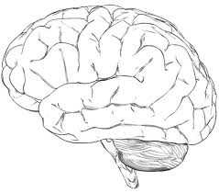
Fine Motor Skills Draws on a Wide Set of Neural Functions
Working Memory
Impulse Control
Visual Perception
Executive Functions
Spatial Transformations
Motor Planning
Visuo-spatial
Hand/Finger Strength
Proprioception
Motor Precision
Attention/On Task
Visual Motor
Sensorimotor
Notes:
Attention/On Task

Slide 30
Copy This Design

Slide 31
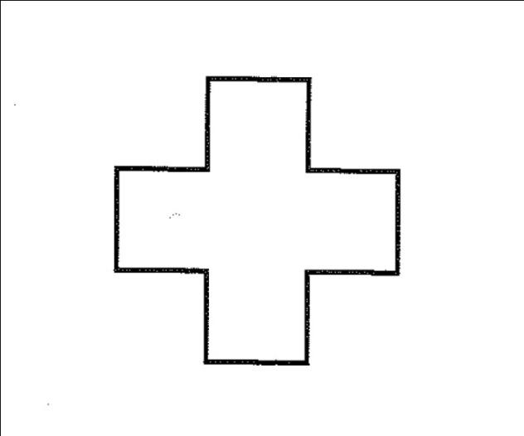
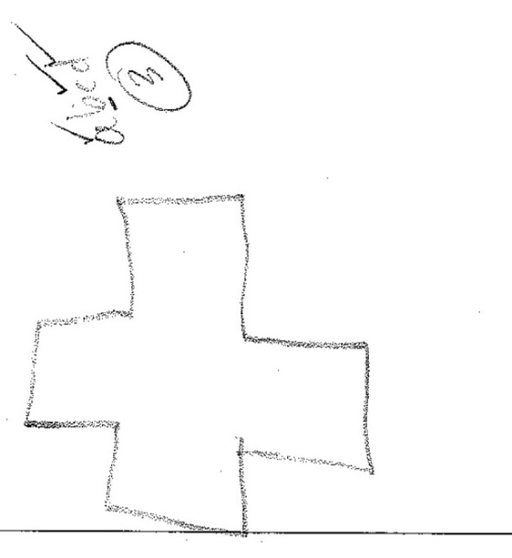
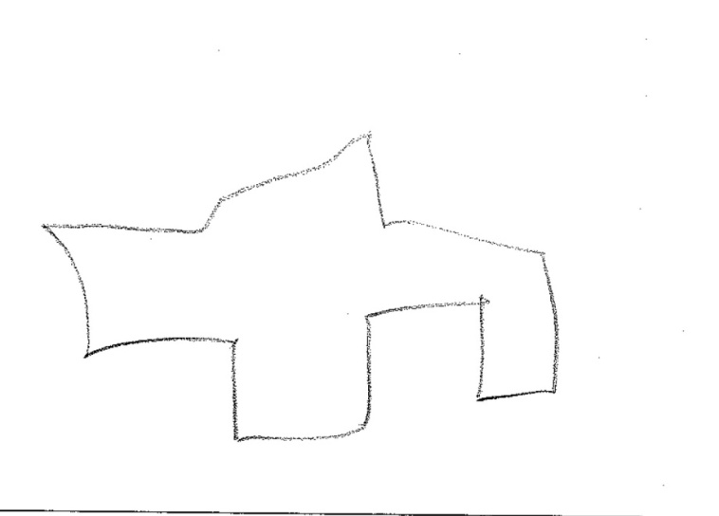
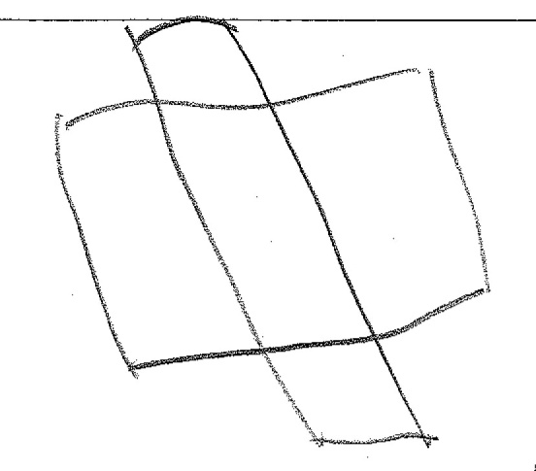
Minds in Motion, 2009

Slide 32

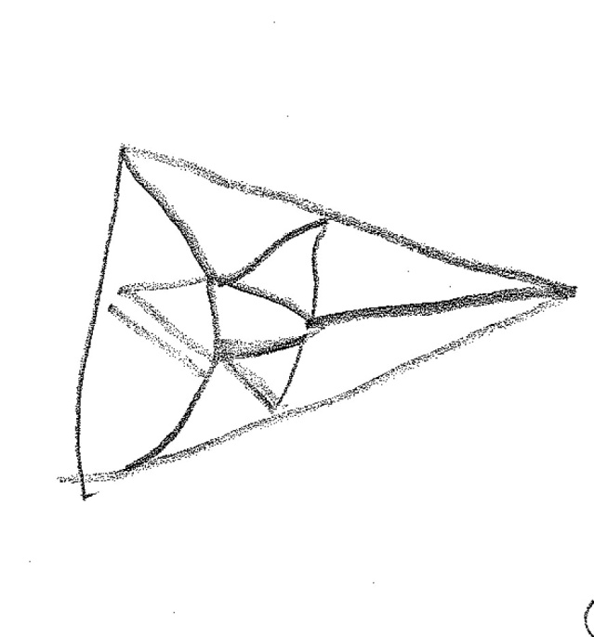
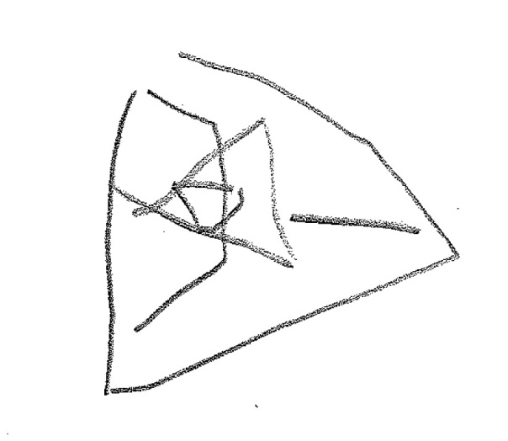
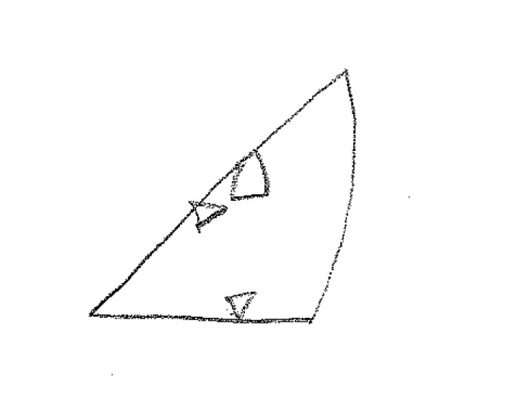
Minds in Motion, 2009
Notes:
1010

Slide 33
Implementation of Minds in Motion
WINGS for Kids
  Afterschool program in 3 schools in Charleston, SC
  3 hours per day five days a week
  Social Emotional Learning (SEL) curriculum
  Very high risk children
MIM Implementation
  Randomize 87 Children to MIM or regular activity
  45 minutes/day during “Choice Time”
  27 weeks
  7 groups of 5-7 children
  Kindergarten and first graders
  Implemented by WINGS leaders
Notes:
LOW PERFORMING SCHOOLS
SEL- HIGHLY STRUCTURED, INTENSIVE TRAINING, BEHAVIORAL STRAT, LEARNING OBJECTIVES, SEL LANGUAGE
99% Free and Reduced Lunch
91% African-American
1% Caucasian
8% Biracial
49% Female
51% Male
99% Free and Reduced Lunch

Slide 34
Study Design
Kindergarten and 1st graders in WINGS randomly assigned to Minds in Motion (n=42) or business as usual (n=41)
Fall 2010 and Spring 2011 Assessments
  Attention and Executive Functions
  Visuospatial Processing
  Copy-Design skills
  Visuo-motor skills
  Five math measures
  General Knowledge
  Working Memory

Slide 35
Criteria for New Activities
Fun and engaging
Easy to train
Easy to administer to large groups
Emphasis on copying designs and underlying processes
Vary in complexity
Easily replicable
Low cost
Notes:
WE KNEW TO BE SUCCESSFUL WITH CURRIC THERE WERE 3 AREAS THAT WERE CRUCIAL emerged from our work in the field- from In order to be successful, we had to make our program
Fun and engaging- being inserted into the public schools at a time of day that is challenging, with a task that runs someone inconsistent with the other things going on at this time in the after school program (e.g. playground!!)
Easy to train- we needed to choose activities and materials that would be easy to implement- that would lend themselves to minimal differences across teachers, and high level of detail in the lessons to accommodate the lowest common denominator in terms of teacher competence
Other criteria emerged from the lab- conversations about constructs and outcome measures. These included
Easy to Administer to Large Groups- we learned that group size really affects success of the lesson- needs to drive choices we make
Emphasis on copying designs- from lab. Can we find activities that get at those components of design copy that lead to greater math performance. We certainly knew that we could not have our intervention be paper pencil copying of designs. But we could find other mediums, materials that lend themselves to the copying of a pattern, design, picture etc.
Vary in complexity- choose activities that would work for the lowest kindergartner and the highest 3rd grader
Other was big picture criteria as we think about scaling up, manualizing the curriculum
Easily scalable- quantity and size of materials, level of prep, etc.
Low cost

Slide 36
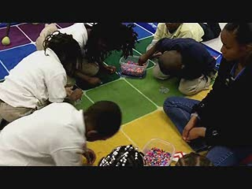
Fuse Beads

Slide 37
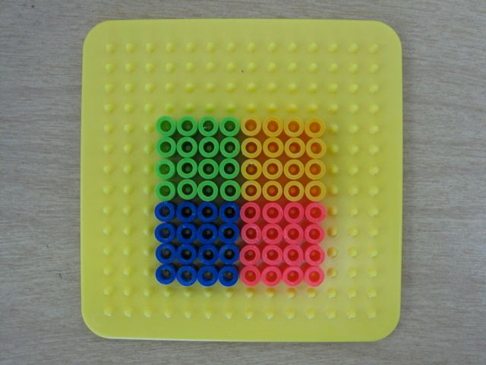
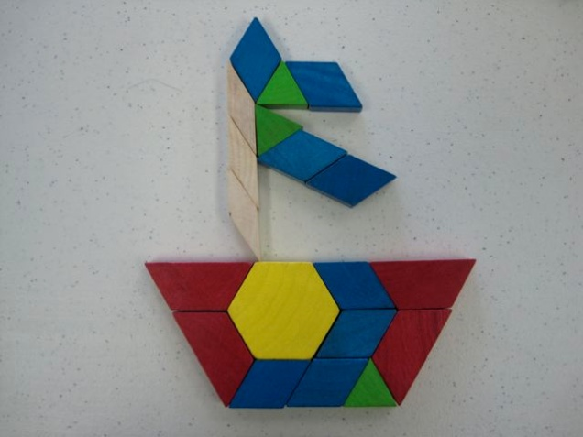
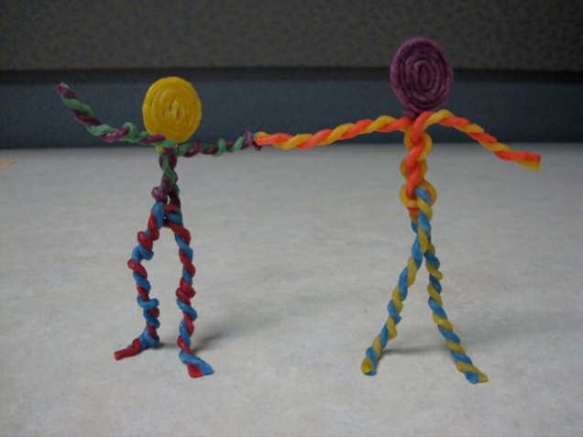

Example Activities
Fuse Beads
Pattern Blocks
Wikki Stix
Legos
Notes:
Show AC ACTIVITIES:
THESE ARE SOME EXAMPLES (SOME YOU MAY RECOGNIZE, OTHERS NOT)
GO OVER EACH MATERIAL
EVERY AC ACTIVITY HAD THE SAME STRUCTURE TO ITS LESSON
INTRODUCE MATERIAL
COPY A PATTERN
“I have different designs and will ask you to make one that looks just like the one I give you”
We deliberately created the designs in the lab (for each material we used them, figured out designs with 3 different levels of complexity, made them, and then took pictures of them, and provided a color photo of these pictures ALL VERY INTENTIONAL
FREE FORM- INCLUDED TEAMWORK, COPY WHAT I SAY, CATEGORY
LESSON DIFFERENTIATION
Each of our arts and crafts activities included basic instructions, then a copy design activity, then a free form period of time. The way that we did this was by providing the design or the pattern we wanted them to use in the lab, then taking colored photographs from which to the students were to copy. We always created numerous designs that tapped at least 3 levels of difficulty.
We created and photographed because wanted to make sure that all groups were using the same designs to copy and we knew that it would be too labor intensive for the instructors to be creating these themselves. There were a lot of designs ultimately

Slide 38

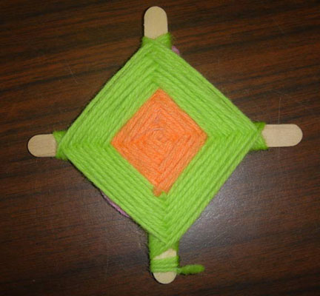
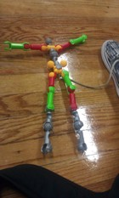
More Example Activities
Colorforms
God’s Eye
ZOOB

Slide 39
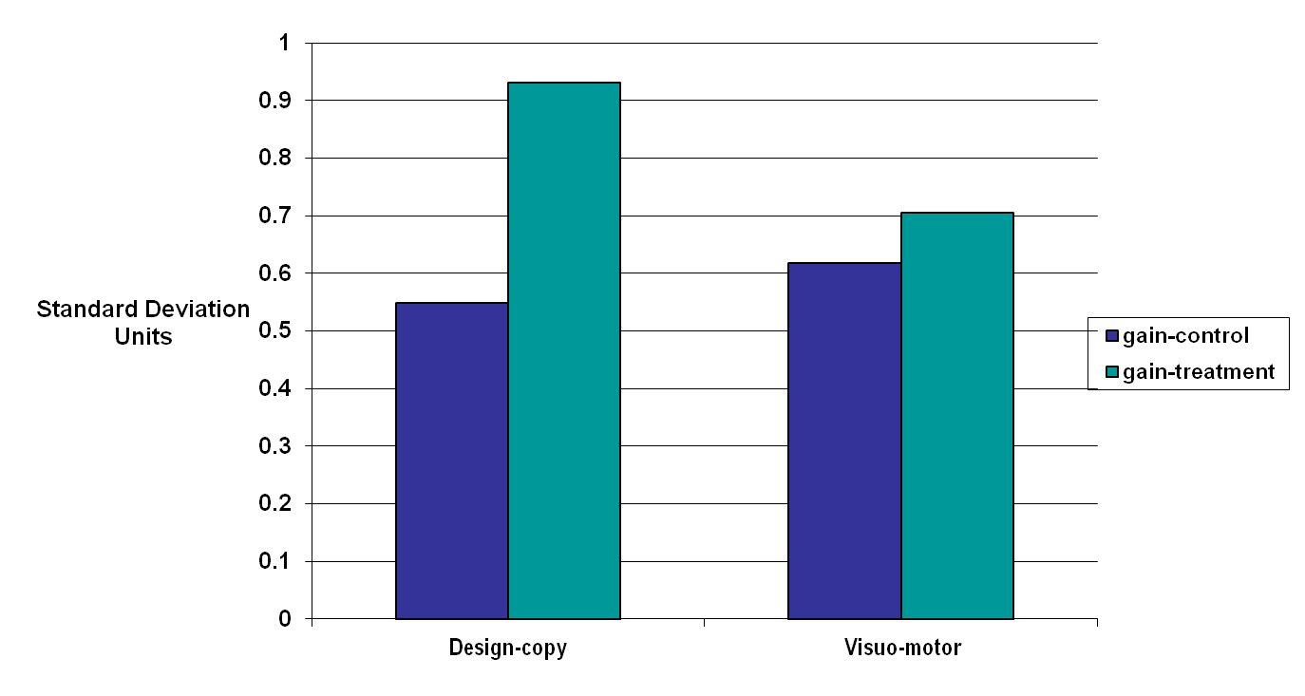
Large gains in Copy-Design, But Not Sensorimotor Skills
**

Slide 40
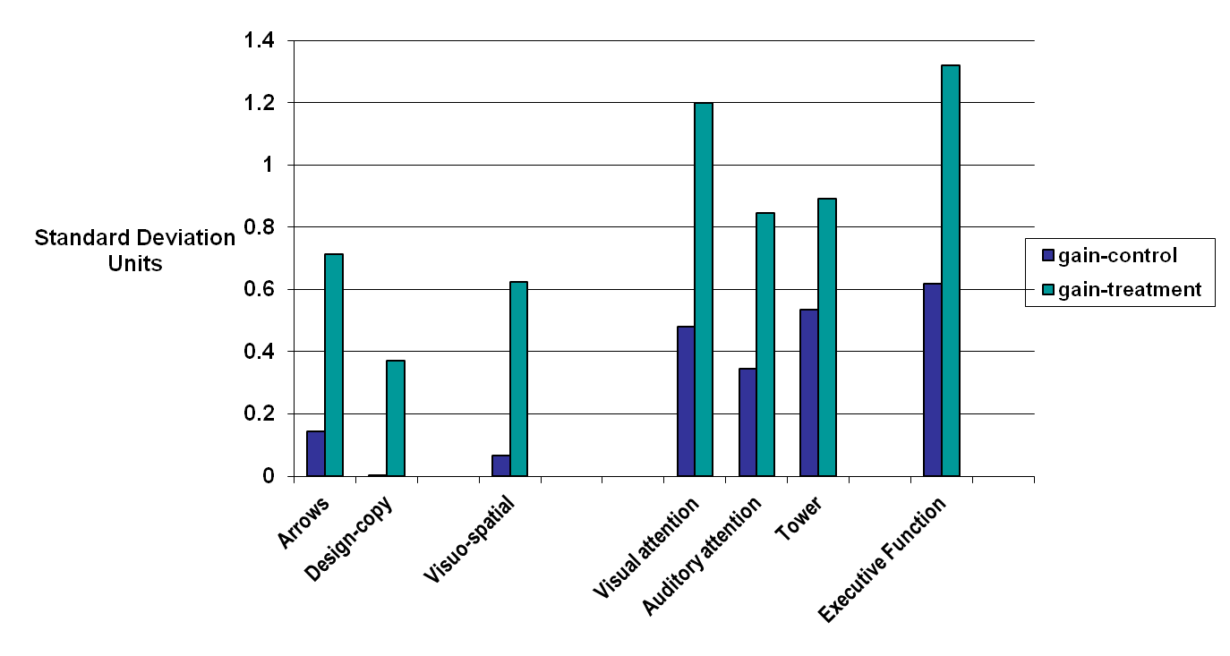
Very Large Gains in Executive Function and Visuo-spatial Skills
****
***
***
**
***
*

Slide 41
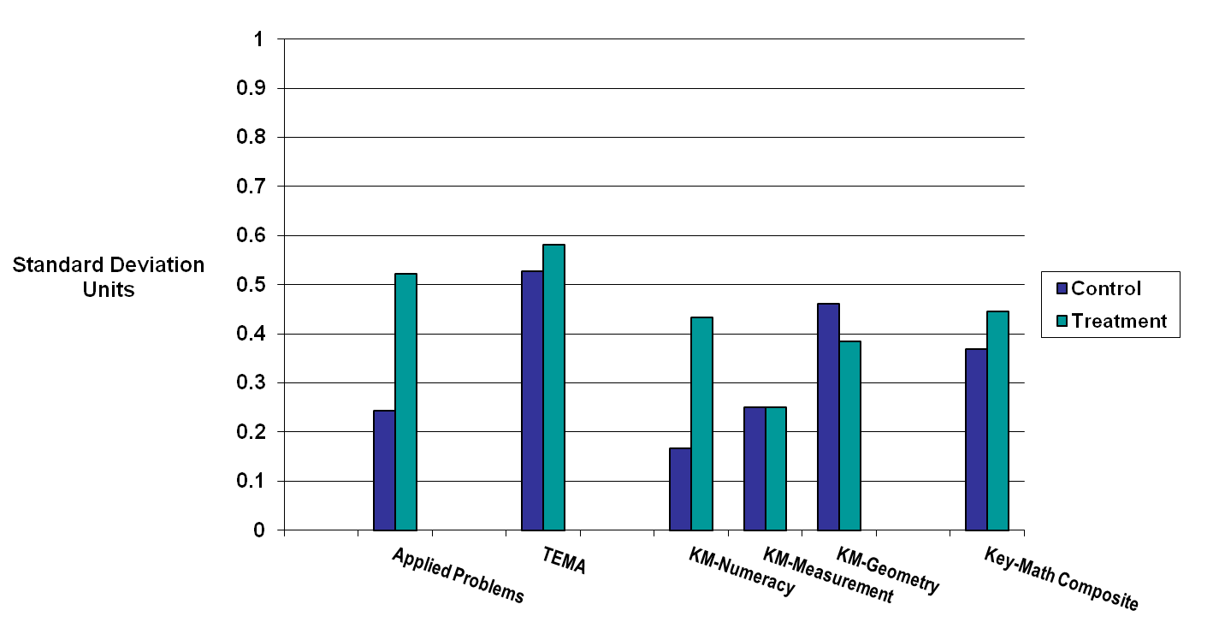
Significant Gains in Two Math Measures:
Applied Problems and Numeracy
*
*

Slide 42
Math Gains Very Large Mainly for 1st Grade Students

Slide 43
MIM Intervention Lifted Visuo-Spatial Skills
From 33rd to 47th Percentile
National Percentile

Slide 44
MIM Intervention Lifted Executive Function Skills
From 27th to 51st Percentile
National Percentile

Slide 45
MIM Intervention Lifted Applied Problem Skills
From 34th to 41st Percentile
National Percentile

Slide 46
Critical Questions Remain
Can results be replicated?
Will the skills decay without further intervention?
Will effects show further improvement in a second year?
Will math scores increase over time?
Would intervention work in other after-school programs

Slide 47
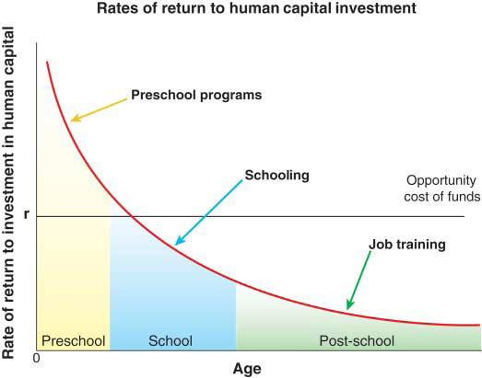
Earlier interventions have higher benefits-cost ratios
Motivation of the study
Rates of return to human capital investment in disadvantaged children.
30 JUNE 2006 VOL 312 SCIENCE www.sciencemag.org
Notes:
1. The second point is:
Early interventions work better than later interventions.
2. Heckman calculated benefits cost ratios for interventions at 3 time points
r = break even point for a dollar invested in intervention
3. Preschool good investment, others we are losing money
4. Not only do they cost more, they are not very effective
Summarize two points
1. Disadvantaged children come to kindergarten behind in academic skills
2. Early interventions work better.
Point to the need to develop preschool interventions for disadvantaged.
payout per year per dollar invested in human capital programs at different stages of the life cycle for the marginal participant at current levels of spending.
This analysis is based on studies such the Perry Preschool Project, in which disadvantaged children (3-4 yo) were randomly assigned to a intervention (2 years) or control group. The children were followed-up in their 40’s. Intervention group had:
Higher graduation rates
Higher salaries
Higher rates of home ownership
Lower rates of welfare use
Less involvement with crime
And fewer out-of-wedlock births
Abecedarian started 4mo old. Randomly assigned. Childcare for 6-8 hours a day 5 days a week until k entry.
Such intervention are compared to typical school intervention (remediations) such as grade retention and IEP’s or post-school interventions such as job training.
The opportunity cost of funds (r) is the payout per year if the dollar is invested in financial assets (e.g., passbook savings) instead.
An optimal investment program from the point of view of economic efficiency equates returns across all stages of the life cycle to the opportunity cost.
we overinvest in most schooling and post-schooling programs and underinvest in preschool programs for disadvantaged persons.
TRANS – (Zoom in) This research demonstrates that Early experiences are very important for adult outcomes. What I want to do is focus in on early childhood education.
These two points emphasize the need to develop appropriate preschool interventions aimed at addressing skill deficits in disadvantaged children.

Slide 48
Recent Research Suggests Basic Assumptions
Underlying Policies May be Problematical (I)
More early instruction and more time and improved quality of later instruction by better teachers in math and reading is sufficient to lift later scores
Activities before school entry and subjects that seem somewhat peripheral to math and reading are critical to later scores skills
Improving current schools and teachers is the central strategy to improving children’s achievement
Children’s achievement may be impacted as much by increasing the quality, programs and use of “extended and out of school” time than making in-school time more productive
Poor schools and teachers and lack of accountability are the primary cause of slow progress on achievement and closing achievement gaps
Quality and time spent on of out-of-school-time and in-school subjects that build executive function and fine motor (arts, music, physical education) and early science and social science likely more important, but teachers and schools have limited leverage on out of school time or curriculum

Slide 49
Here is the Message (I)
An alternative to “Drill and Kill” as the dominant U.S. educational policy may be developing
New research suggests that critical skills used in later reading and math are not learned doing earlier reading or math.
These critical skills start to develop prior to school entry and are learned in activities and subjects that seem peripheral to reading and math.
Deficits in these skills are likely responsible for most achievement gaps for minority and lower income students
Learning these skills likely involves more play activities involving fine motor skills, building stronger socio-emotional skills, more attention to music, arts and early science and social science (both in and outside the classroom)
Many of these skills can be learned in high quality programs in out-of-school time (prior to school entry, after-school and summer)

Slide 50
Here is the Message (II)
Many of the programs and policies that have been developed over the last 25 years will become more effective if the foundational skills are developed
Teachers and schools will become more effective if more children develop these skills
These skills need to be measured and monitored as seriously as achievement

