Slide 1
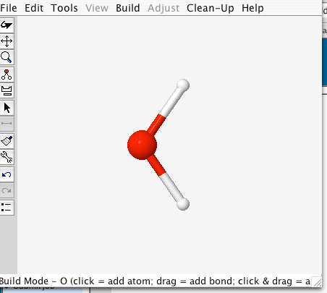
Computational Chemistry – Does WebMO enhance student learning?
Brett Block
Paris High School

Slide 2
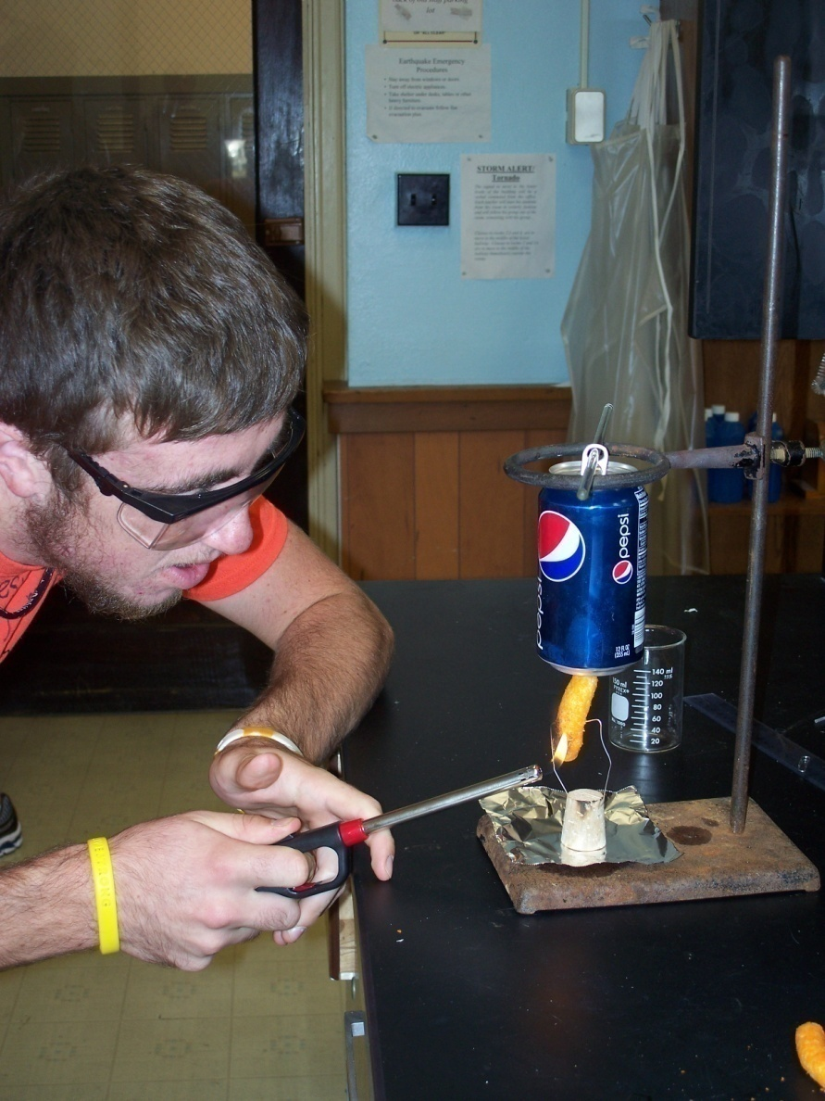
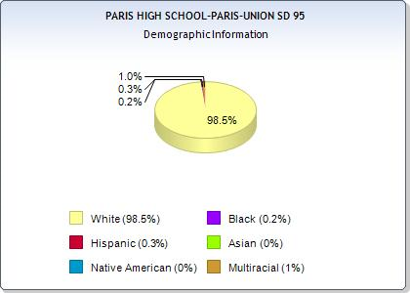
The current enrollment of PCHS fluctuates between 620-650.
The average class size is 16.3.
54.7% are low income.
It is a rural school.
My Students:

Slide 3
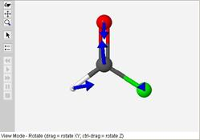
PURPOSE:
During my involvement with ICLCS, I have spent the past
6 years designing, incorporating, and testing WebMO computational program activities in the chemistry curricula
to see if they enhance student learning.
*Is it worth our time?
*Is it effective?
*You need access to the
internet and java.

Slide 4
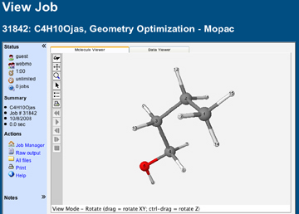
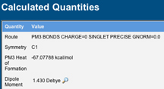
What is WebMO?
WebMO is a free, easily accessible, web-based, 3D- computational modeling program that gives a way for students to visualize a molecule’s structure and run data to see how that structure affects a molecule’s properties.

Slide 5
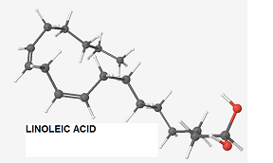
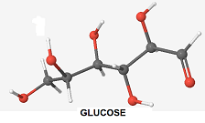
Activity 1: Energy Of Foods Lab
WebMO enhances the lab as students draw glucose (to represent a marshmallow) and linoleic acid (for a chip).
All the classes took a pre-test about sugary vs. fatty foods, the structures of glucose and linoleic acid, and the amount of heat required to form such structures.

Slide 6
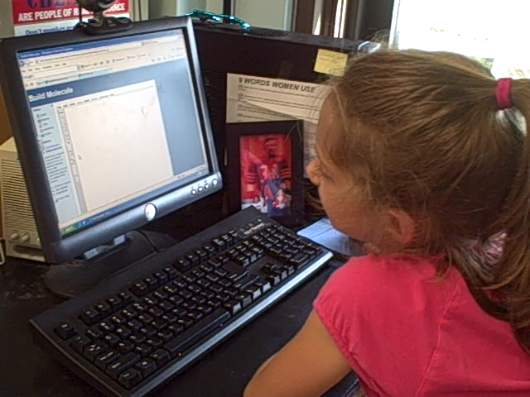
Students made predictions about the heats of formation of glucose vs. linoleic acid. They drew the molecules in the program and analyzed the data.
Payton, age 6, uses WebMO to make a glucose.

Slide 7
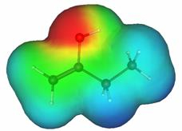
Activity 2 – Penny Lab: Polarity and Dipole Moment
Using WebMO, students compare various solutions (water, butanol, hexane, and acetone) by how many drops of each you can put on a penny. The molecules are then drawn and analyzed in WebMO and the dipole moments observed and recorded.
Electron potential data is viewed to see where the lone pairs of electrons are located on this butanol.

Slide 8
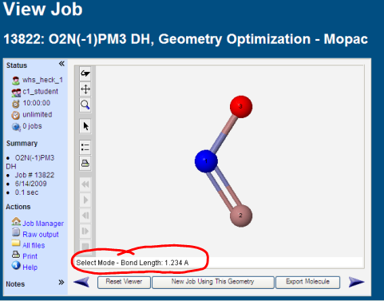
Activity 3: Molecular Geometry Activity:
Used WebMO to build molecules and study their geometry, hybridization, bond lengths, and bond angles. It walks them through electron pair domains.
They draw the Lewis Structures before on paper and predict the geometry, then use WebMO to confirm those predictions.

Slide 9
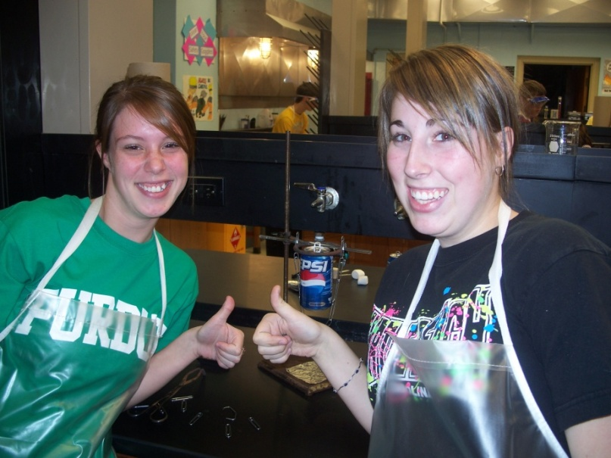
305 Student Opinions:
Worthwhile to use WebMO!!!
WebMO introduces them to a new field of study, computational chemistry.

