Slide 1
Conditions to Support Successful Teaching Challenging Coursework: School Climate and Organization
Elaine Allensworth
April 10, 2012
Notes:
Recognition of the Need to Improve Educational Attainment in Urban Schools
Change in workforce expectations – 21st century workforce obligations
Rise in college expectations among students

Slide 2
Two Current Strategies to Improve Student Learning
Identify strong and weak teachers
  Value added, better teacher evaluation
Increase curricular rigor
  Common core, College-prep curriculum for all
Need to consider the conditions that affect whether these strategies can be effective

Slide 3
Reflection
What efforts are underway or being contemplated to increase curricular rigor and student learning in your school/classroom/district?
What are the challenges that you anticipate/currently face with increasing academic rigor and student learning?
  Through work on the new common standards?
  Through new teacher evaluation practices?
Notes:
Small groups here

Slide 4
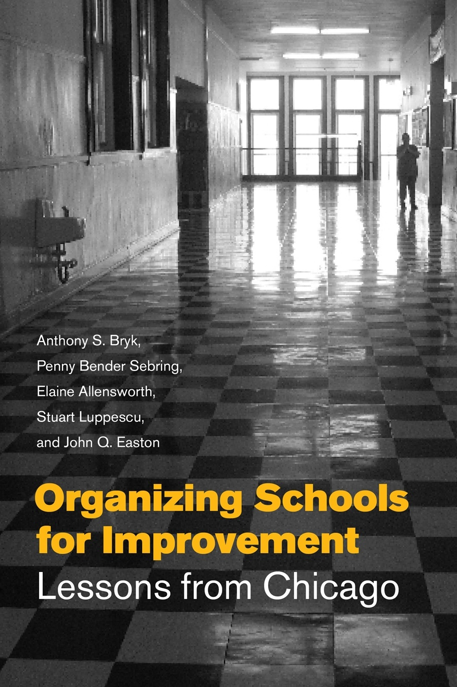
Notes:
The answer to this question is the subject of our study and this book.
internal workings
external conditions
Student test scores – all students in grades 1-8 from 1987 to 1996
Surveys of teachers, students and principals in 260 Chicago elementary schools
Community Study - Human Development in Chicago Neighborhoods
Crime statistics, DCFS records
Value added indicators – change in value added over time as the outcome

Slide 5
Chicago Schools Diverged Considerably in Student Achievement in the 1990s
Notes:
We began to see tremendous variation among schools in the percent of students meeting national norms.
Top quarter of schools or 100 schools– blue line
Bottom quarter started at about the same level but declined over time – yellow.
(Later we replicated our findings through 2005.)

Slide 6
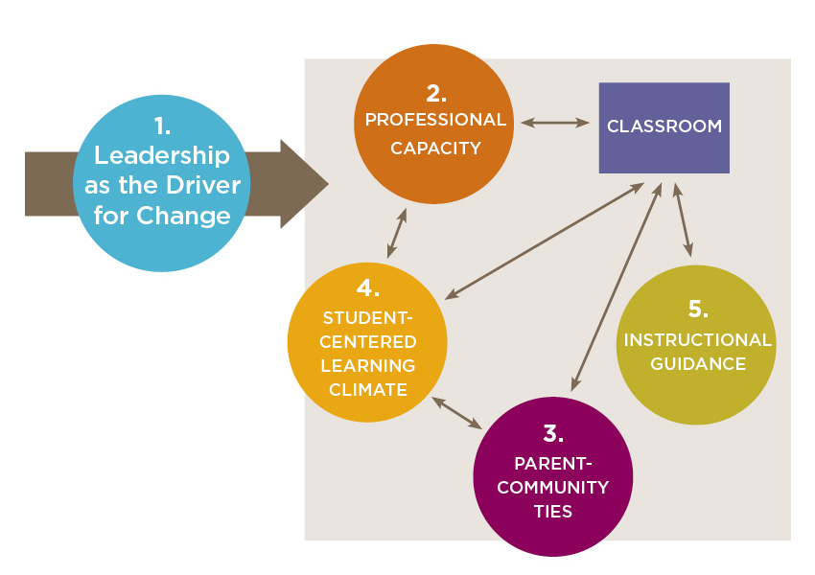
A Framework of 5 Essential Supports
Notes:
School leadership as the driver for change. Principals must be strategic, focused on instruction and inclusive of others in the leadership work. (shared leadership, vision foundation elements)
Professional capacity refers to the quality of the faculty and staff recruited to the school, their base beliefs and values about change, the quality of ongoing professional development, and the capacity of a staff to work together .
Parent-community ties involve active outreach to make school a welcoming place for parents and to strengthen connections to other local institutions.
Student-centered learning climate. This is a safe, welcoming, stimulating and nurturing environment focused on learning for all students.
Instructional Guidance: Refers to the organization of the curriculum, the nature of academic demand or challenges it poses, and the tools teachers have to advance learning (such as instructional materials).

Slide 7
Improvement in learning gains depended on adults working cooperatively, focused on instruction
In schools with a well-aligned curriculum and a strong professional community among teachers
    48-57% substantially improved math/reading
    4-9% were stagnant
Parent –Community
Ties
Student-
Centered Learning Climate
Instructional Guidance
Professional Capacity
Leadership
Notes:
Highlight professional capacity here, but parent-community ties also important. Both important in combination with instruction. Collaborative work was more important than teacher qualifications.

Slide 8
But when adults failed to work cooperatively, no improvement in learning gains.
In schools with a poor learning climate and weak professional community
  0% substantially improved math or reading scores
  41-59% were stagnant
Parent –Community
Ties
Student-
Centered Learning Climate
Leadership
Instructional Guidance
Professional Capacity
Notes:
Weak learning climate – especially order & safety undermined learning growth.
By poor learning climate we mean low expectations and little help and support for students.
Notice that these schools were weak in 2 of 5 areas—student-centered learning climate and professional capacity.
(We found similar results for schools with poor learning climate and poor connections between parents and teachers.)

Slide 9
Strength in Multiple Supports
Real value of the essential supports is in their combined strength.
Schools with strength in 3-5 of supports were 10 times more likely to improve in reading and math than schools weak in most supports.
Sustained weakness over time in one undermined improvement.
Parent –Community
Ties
Student-
Centered Learning Climate
Leadership
Instructional Guidance
Professional Capacity
Notes:
Tied together. Leadership needed to build other 4. Parent community important for climate. Climate & PC together affect instruction.
Initial study 1990-1996. Replicated from 1997-2005. Also observed in high schools, although systematic study hasn’t been done.
Pieces, isolated magic bullet strategies. Strongest evidence was around how people worked together, trust in the school community.

Slide 10
Schools Serving Disadvantaged Communities Are Less Likely to Show Improvements Over Time
50
46
45
42
40
35
35
31
31
31
30
24
23
Expected: 25%
25
Percentage of Schools that Stagnated or Improved
20
20
18
18
15
15
15
10
9
5
0
Mostly Minority
Latino
Racially Diverse
Integrated
African-American
Very Low SES
Low SES
Average SES
Stagnant
Substantially Improved
Notes:
Title. This shows the percentage of schools that stagnated (orange bars) in reading in each of the 7 categories. Schools that stagnated were in the bottom quartile on gains—they did not improve learning gains or the gains got somewhat smaller.
Looking at the first set of bars, we see that 46 percent of truly disadvantaged schools stagnated, while only 9 percent of the integrated schools did so.
Adding the bars for the improving schools, we see that only 15 % of TA schools improved substantially, but 42 % of the integrated schools did so. Note that all categories of schools had improving and stagnating schools. Generally, though, as you move from left to right you see less stagnation and more improvement in reading.
Most social scientists stop at this point, but we wanted to look beyond the usual markers of race, SES to see what community characteristics seemed to make a difference.

Slide 11
Essential Supports lead to learning gains in all kinds of school communities?
Yes, but…
Disadvantaged communities – schools needed robust essential support practices.
Better off communities – some schools improve with even average internal essential supports.
No schools improve with weak internal supports
If external social resources are weak, internal social resources need to be strong
Notes:
Read slide.
.

Slide 12
How does attention to organizational structures contrast with other efforts to improve learning?
How do these conditions promote or inhibit the capacity of teachers to be effective?
Notes:
Now let’s look at two popular strategies—recruit highly qualified teachers, enact the right, rigorous curriculum

Slide 13

Teacher qualifications matter, but context matters more
Teacher Qualifications and School Climate: Examining Their Interrelationship for School Improvement
By Karen J. DeAngelis & Jennifer B. Presley
Relationships of Teacher Quality Indicators and Organizational Supports with Value-Added on Reading and Math Tests
 | Reading | Math
Teacher qualifications | .12** | .08
Teacher experience | .08 | .10**
Leadership | .14** | .21***
Parent Relationships | .34*** | .41***
Professional Community | .17** | .25***
Safety & Order | .26*** | .40***
Notes:
These control for student body composition.
Teacher qualifications relationships decline somewhat when control for essential supports.

Slide 14
Regardless of teacher quality, a poor school climate prevents learning gains
Reading Gains
Notes:
ITAC: ACT Scores, college selectivity, passing basic skills test on first attempt, full certification
Gains from value-added models

Slide 15
Regardless of teacher quality, a poor school climate prevents learning gains
Mathematics Gains
School Climate
Notes:
ITAC: ACT Scores, college selectivity, passing basic skills test on first attempt, full certification

Slide 16
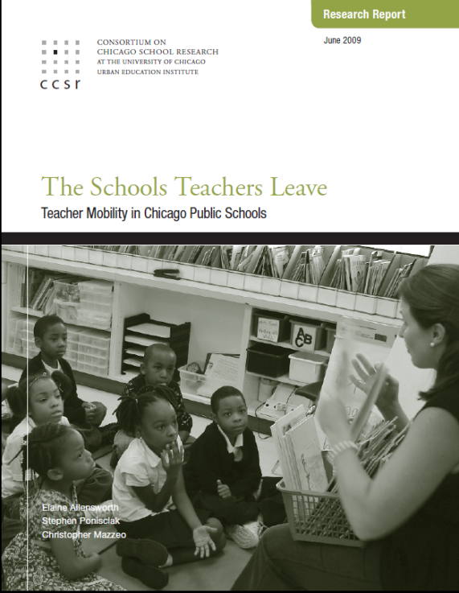
Teachers tend to leave schools where it is hard to be effective
Teachers are more likely to stay in schools with better:
School leadership
Collaborative work among teachers
Parental involvement
Safety and order
These explain differences in mobility by school racial composition & economics
Comparing conditions in time 1 to mobility at time 2
Controlling for teacher & student characteristics, school structure

Slide 17

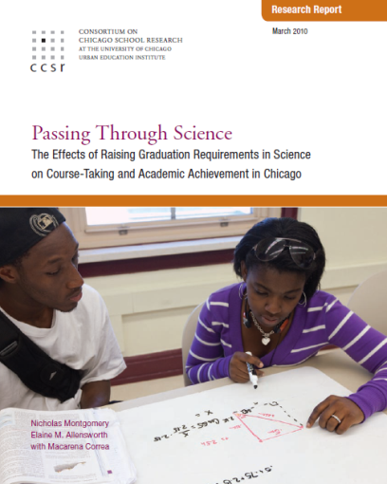
Curricular reforms in Chicago have brought more demanding coursework without improvements in achievement
Requiring college-prep coursework brought:
  Students taking more college-prep classes
  No improvements in test scores
  Fewer students graduating
  Fewer students attending 4-year colleges, especially among those most qualified; persistence unchanged
High-quality, aligned curriculum implementation with coaching and PD (IDS program) brought:
  More interactive pedagogy, more time doing math
  No improvements in test scores, grades
Notes:
Another popular strategy is curricular reform.

Slide 18
Curricular policies were undermined by problems with school climate and professional capacity
Subsequent research showed…
Orderly classrooms are a pre-requisite for academic demand to affect student learning
  Increased rigor produces little increase in learning if school & classrooms are disorderly
Order is more difficult when demands rise
  Students withdraw when work gets hard, unless support increases
  Expansion of rigorous classes to low-skilled students affects learning climate for high-skilled students
Schools may lack professional capacity to teach demanding classes to all
Notes:
Size of effects on demand & order are similar – EXCEPT that there’s an interaction effect where if one is weak it counteracts other, AND order gets worse as demand rises.
Math and science face the same issues as other classes, but in different ways.
Math (especially) & science more likely to have clear standards/instructional goals. Maintain rigor. BUT more likely to have poor classroom management, engagement, support for students – climate less likely to be good in math & science classrooms.
Expansion of math & science to all limited capacity of schools to offer high-level math & science classes to high-achieving students.

Slide 19
Two decades of work in Chicago suggests there are no “magic bullet” solutions
Requiring more rigorous curriculum alone not effective
  Learning climate and professional capacity not sufficient to support new curricula (college prep for all, IDS)
Teachers likely to leave in schools with weak organizational supports
  Collaborative work more important than teacher backgrounds for sustained school improvement
  Teachers need support to be effective
  Suggests narrow interventions are tools for organizational improvement, not ends in themselves
Notes:
Standards, evaluation methods, accountability are tools, but are not ends in themselves.

Slide 20
School improvement requires systemic work on multiple fronts
Five Essential Supports for School Improvement
School Leadership as Driver for Change
Robust Parent-Community Ties
Strong Professional Capacity
Student-Centered Learning Climate
Instructional Guidance
Parent –Community
Ties
Student-
Centered Learning Climate
Leadership
Instructional Guidance
Professional Capacity
Notes:
The social organization is really key – how people work together, focused on student growth.

Slide 21
Reflection
In what ways do the research findings resonate, or are similar to something you have experienced in your own work?
  Thinking specifically about the challenges you came up with earlier, what connections do you see between these and the research?
How could a school use the new curriculum standards to build each of the five essential supports?
  What needs to happen to make the new standards effective at improving student achievement, not just a change in what is taught?
  What are the potential barriers?
How could a school use the new teacher evaluation frameworks to build the five essential supports?
  What are the potential barriers? How could those barriers be addressed?
Notes:
Small groups here – Each group tackle one question?

Slide 22
For more information please visit ccsr.uchicago.edu

