Slide 1



Assessment Challenges and Opportunities Accompanying the New Math and Science Standards: Will We Create Tests Worth Teaching To?
Jim Pellegrino

Slide 2
Overview
Opportunities for Systemic Improvement in STEM Education: Defining Competence
Challenges in Assessing What’s Implied by the “New” STEM Education Standards
What are the Prospects for Success?
Will Race to the Top Help to Get Us There?
Will We Have Tests Worth Teaching To? --Some Final Thoughts

Slide 3



Slide 4
New Definitions of Competence
Both the CCSS for Mathematics and the NRC Science Framework have proposed descriptions of student competence as being the intersection of knowledge involving:
  important disciplinary practices and
  core disciplinary ideas, with
  performance expectations representing the intersection of core content and practices.
Both view competence as something that develops over time & increases in sophistication and power as the product of coherent curriculum & instruction

Slide 5
Scientific & Engineering Practices
1. Asking questions and defining problems
2. Developing and using models
3. Planning and carrying out investigations
4. Analyzing and interpreting data
5. Using mathematics and computational thinking
6. Developing explanations and designing solutions
7. Engaging in argument
8. Obtaining, evaluating, and communicating information

Slide 6
A Core Idea for K-12 Science Instruction is a Scientific Idea that:
Has broad importance across multiple science or engineering disciplines or is a key organizing concept of a single discipline
Provides a key tool for understanding or investigating more complex ideas and solving problems
Relates to the interests and life experiences of students or can be connected to societal or personal concerns that require scientific or technical knowledge
Is teachable and learnable over multiple grades at increasing levels of depth and sophistication

Slide 7

Goals for Teaching & Learning
Coherent investigations of core ideas across multiple years of schooling
More seamless blending of practices with core ideas
Performance expectations that require reasoning with core disciplinary ideas
  explain, justify, predict, model, describe, prove, solve, illustrate, argue, etc.
Crosscutting Concepts
Core
Ideas
Practices

Slide 8
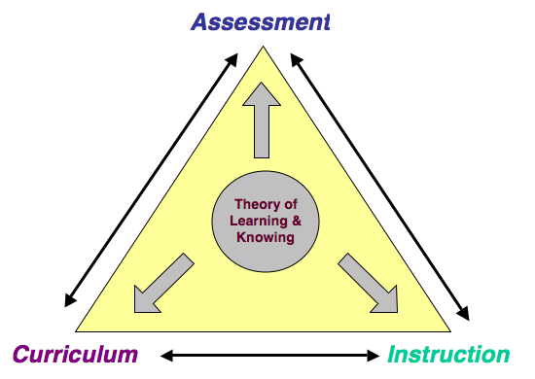
Aligning Curriculum,
Instruction & Assessment
Standards

Slide 9

Assessment as a Process of Reasoning from Evidence
cognition
  theory, model and data about how students represent knowledge & develop competence in the domain
observations
  tasks or situations that allow one to observe students’ performance
interpretation
  methods for making sense of the data
interpretation
observation
cognition
Must be coordinated!

Slide 10

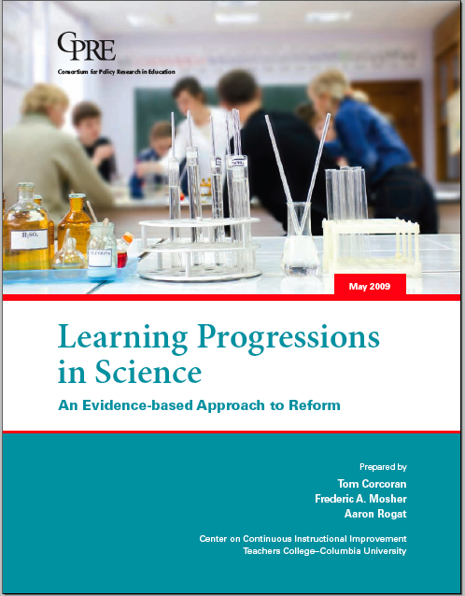

Slide 11
Why Models of Development of Domain Knowledge are Critical
Tell us what are the important aspects of knowledge that we should be assessing.
Give us strong clues as to how such knowledge can be assessed
Can lead to assessments that yield more instructionally useful information
  diagnostic & prescriptive
Can guide the development of systems of assessments intended to cohere
  across grades & contexts of use

Slide 12
Issues of Assessment Design & Development
Assessment design spaces vary tremendously & involve multiple dimensions
  Type of knowledge and skill and levels of sophistication
  Time period over which knowledge is acquired
  Intended use and users of the information
  Availability of detailed theories & data in a domain
  Distance from instruction and assessment purpose
Need a principled process that can help structure going from theory, data and/or speculation to an operational assessment
  Evidence Centered Design

Slide 13
Evidence-Centered Design
What will you accept as evidence that a student has the desired knowledge?
Exactly what knowledge do you want students to have and how do you want them to know it?
What task(s) will the students perform to communicate their knowledge?
How will you analyze and interpret the evidence?
claim space
evidence
task
Consider what this might mean when it comes to performance expectations integrating Disciplinary Core Ideas & Practices
For the Redesign of AP Science this was Instantiated through the Intersection of Core Ideas & Science Reasoning Practices

Slide 14
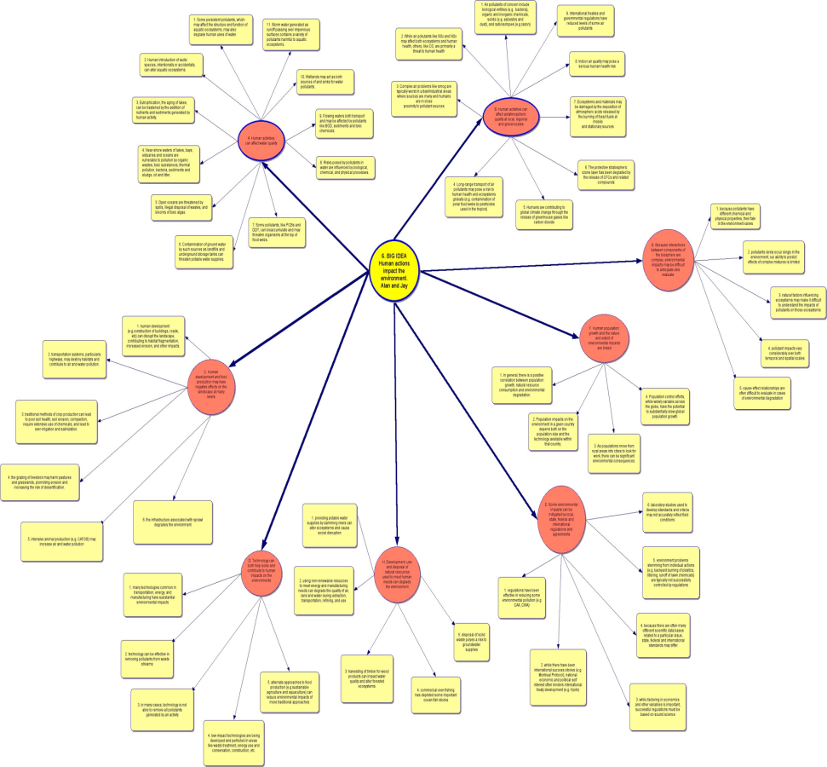
AP Content & Science Practices
Use representations and models to communicate scientific phenomena and solve scientific problems.
Use mathematics appropriately.
Engage in scientific questioning to extend thinking or to guide investigations within the context of the AP course.
Plan and implement data collection strategies in relation to a particular scientific question.
Perform data analysis and evaluation of evidence.
Work with scientific explanations and theories.
Connect and relate knowledge across various scales, concepts, and representations in and across domains.
Core Ideas
Science practices

Slide 15
Illustrative Claims and Evidence
AP Biology
Big Idea 1: The process of evolution drives the diversity and unity of life.
EU 1A: Change in the genetic makeup of a population over time is evolution.
L3 1A.3: Evolutionary change is driven by genetic drift and artificial selection.
Skill 6.4: The student can make claims and predictions about natural phenomena
based on scientific theories and models.
The Claim: The student can make predictions about the effects of natural selection versus genetic drift on the evolution of both large and small populations of organisms.
The Evidence: The work will include a prediction of the effects of either natural selection or genetic drift on two populations of the same organism, but of different sizes; the prediction includes a description of the change in the gene pool of a population; the work shows correctness of connections made between the model and the prediction and the model and the phenomena (e.g. genetic drift may not happen in a large population of organisms; both natural selection and genetic drift result in the evolution of a population).
Suggested Proficiency Level: 4

Slide 16
Illustrative Claims and Evidence
AP Chemistry
EU 4A: Reaction rates are determined by measuring changes in concentrations of reactants or products over time, and depend on temperature and other environmental factors.
Big Idea 4: Rates of chemical
reactions are determined by details of the molecular collisions.
L3 4A.2: The rate law shows how the rate depends on reactant concentrations.
Skill 5.1: The student can analyze data to identify patterns or relationships.
The Claim: The student can analyze data that shows how reactant and product concentrations change as a reaction progresses to identify the rate law.
The Evidence: The work will show saliency of the patterns identified (e.g. change in slope as the reaction progresses), adequacy of the pattern description (e.g. description of slope being related to rate of reaction and slowing of the rate with time), appropriateness of terminology (e.g. rate of reaction, order of reaction and rate constant), appropriateness of analysis of the slope as indicating the rate, the change in slope as being related to the change in concentration of reactant species, and the use of this to derive the order of the reaction, and
that the data are structured to expose the relationship between the reactant concentrations and the rate of the reaction.
Suggested Proficiency Level: 3

Slide 17
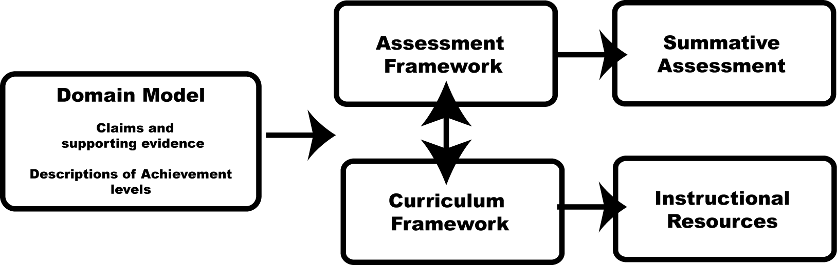
Connecting the Domain Model to
Curriculum, Instruction, & Assessment
Notes:
Kristen

Slide 18



Slide 19
Lessons Learned from the AP Redesign Project
No Pain -- No Gain!!! -- this is hard work
Backwards Design and Evidence Centered Design are challenging to execute & sustain
  Requires multidisciplinary teams
  Requires sustained effort and negotiation
  Requires time, money & patience
Value-added -- Validity is “designed in” from the start as opposed to “grafted on”
  Elements of a validity argument are contained in the process and the products

Slide 20
Where Do We Stand?
We have a much better sense of what the development of competence should mean and the possible implications for designing coherent mathematics & science education
We have examples of thinking through in detail the juxtaposition of disciplinary practices and core content knowledge to guide the design of assessment
  AP Redesign Project
  Multiple Assessment R&D Projects

Slide 22
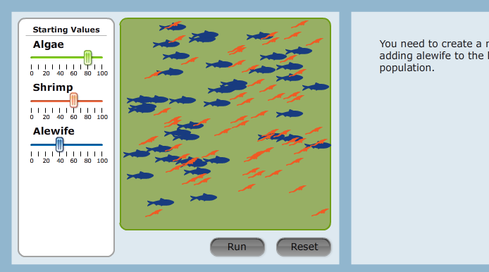
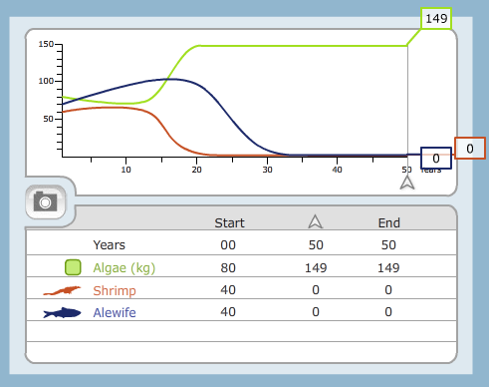
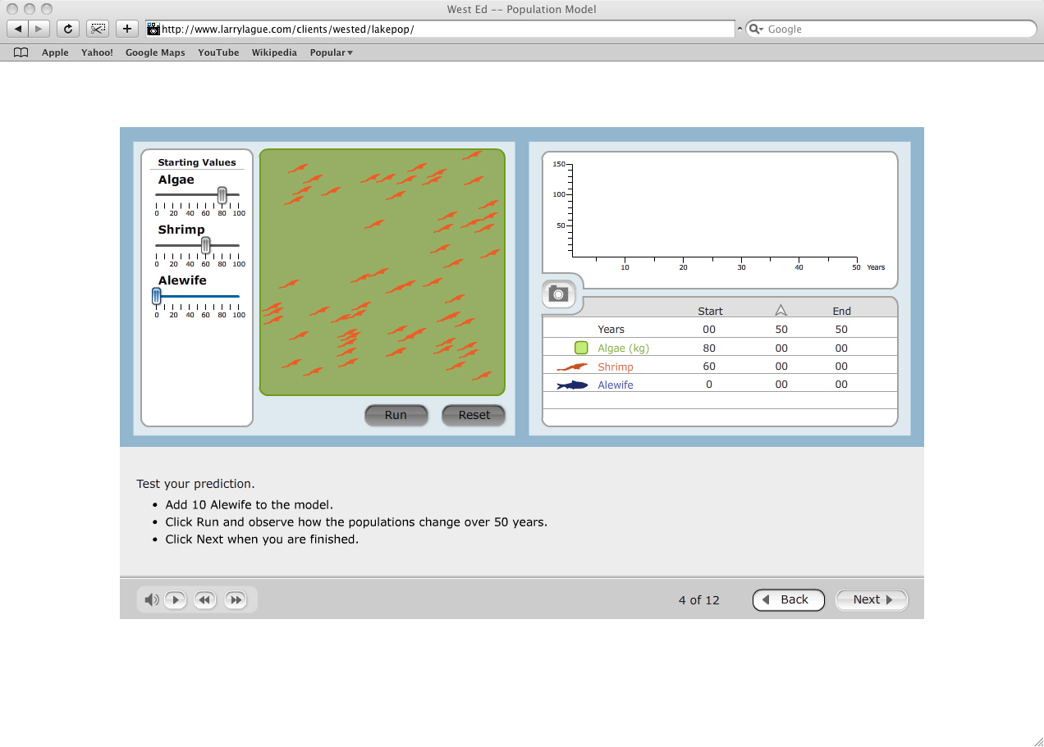
Life Science Simulation
In the experiment that you just analyzed, the amount of alewife was set to 20 at the beginning.
Another student hypothesized that the result might be very different if she started with a larger or smaller amount of alewife at the beginning.
Run three experiments to test that hypothesis. At the end of each experiment record your data by taking pictures of the resulting graphs.
After three runs, you will be shown your results and asked if it makes any difference if the beginning amount of alewife is larger or smaller than 20.
Notes:
22

Slide 24
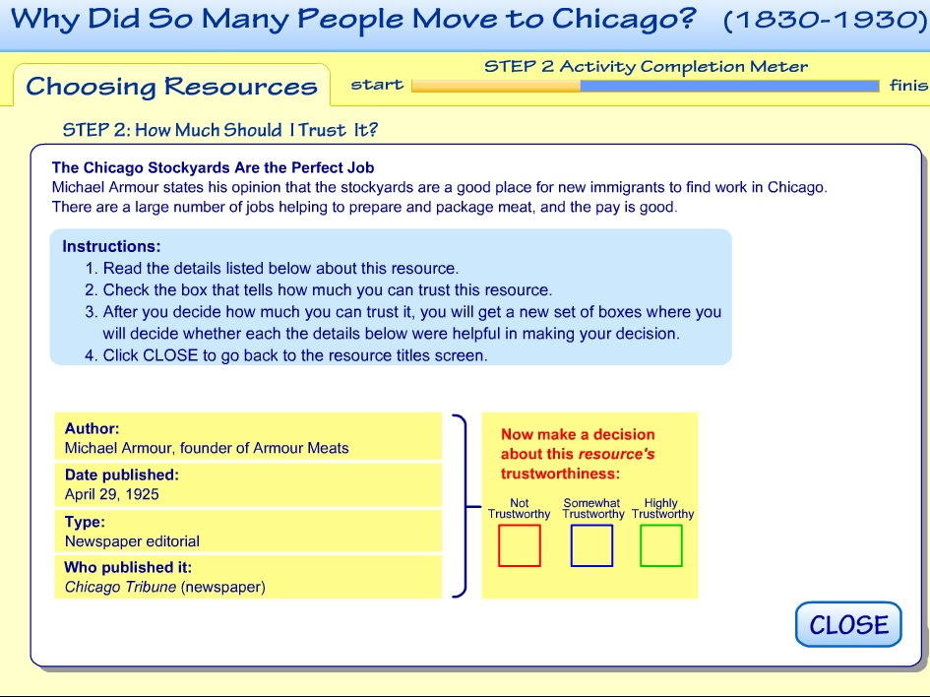

Slide 25
What’s Left to Do? – A LOT!!!
We need to translate the standards into effective models, methods and materials for curriculum, instruction, and assessment.
  Need clear performance expectations
  Need precise claims & evidence statements
  Need task models & templates
We need to use what we know already to evaluate and improve the assessments that are part of current practice, e.g., classroom assessments, large-scale exams, etc.

Slide 26

Desired end product is a multilevel system
  Each level fullfills a clear set of functions and has a clear set of intended users of the assessment information
  The assessment tools are designed to serve the intended purpose
    Formative, summative or accountability
    Design is optimized for function served
The levels are articulated and conceptually coherent
  They share the same underlying concept of what the targets of learning are at a given grade level and what the evidence of attainment should be.
  They provide information at a “grain size” and on the “time scale” appropriate for translation into action.

Slide 27
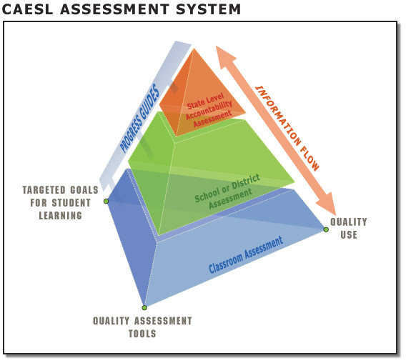
What Such a System Might Look Like
An Integrated System
Coordinated across levels
Unified by common learning goals
Synchronized by unifying progress variables
Multilevel Assessment System

Slide 28
The Key Design Elements of Such a Comprehensive System
The system is designed to track progress over time
  At the individual student level
  At the aggregate group level
The system uses tasks, tools, and technologies appropriate to the desired inferences about student achievement
  Doesn’t force everything into a fixed testing/task model
  Uses a range of tasks: performances, portfolios, projects, fixed- and open-response tasks as needed

Slide 29
RttT Assessment Consortium Membership
Assessment Consortia bershi
Washington, DC
Hawaii
PARCC State
SBAC State
Both consortia
Notes:
29

Slide 30






The PARCC Assessment System
(July 2011 revision)
English Language Arts and Mathematics, Grades 3–8 and High School
PARTNERSHIP RESOURCE CENTER: Digital library of released items; formative assessments; model content frameworks; instructional and formative tools and resources; student and educator tutorials and practice tests; scoring training modules; professional development materials; and an interactive report generation system.
Component 1
EARLY ASSESSMENT
Component 2
MID-YEAR ASSESSMENT
Comp 5
Comp 3
Comp 4
Early indicator of knowledge and skills to inform instruction, supports, PD
ELA/Literacy
Speaking
Listening
PERFORMANCE
ASSESSMENT
ELA
Math
END-OF-YEAR
ASSESSMENT
Mid-Year Performance-Based Assessment
(Potentially summative)
Flexible timing
Timing of formative components is flexible
Formative
Assessment
Summative,
but not used
for accountability
Summative assessment
for accountability

Slide 31
PARCC Implementation Milestones
2011-2012 | Item and task development, piloting of components Release of Model Content Frameworks and prototype items and tasks Development of professional development resources and online platform
2012-2014 | Field testing
2014-2015 | New summative assessments in use
Summer 2015 | Setting of common achievement standards

Slide 32
The PARCC & SBAC Dilemma
Many things to do but very little time to completion
  Solve all of the design, technical, & implementation problems by end of 2014 – Validation???
Capacity of the field to design, build, and validate high quality & coherent assessment materials
The possibly conflicting constraints imposed on the final product/system by the USDoE
  Cover the depth & breadth of the standards
  Provide evidence to measure student growth
  Provide scores for teacher, principal & school accountability purposes

Slide 33
Will We Have Tests
Worth Teaching To?
There is considerable interest in improving STEM instruction and achievement
  Common core Math standards
  NRC Science Framework ➔ Achieve Standards
  Considerable $$$ for better assessment
The drive to develop common standards and assessments could be beneficial for K-12+ but matters of timing, inconsistent educational policies, & the state of R&D might lead to unfulfilled promises, dissatisfaction, & unintended negative consequences.

Slide 34
Will We Have Tests
Worth Teaching To?
Desires of the policy community often conflict with the capacities of the R&D community
  Need for better coordination and communication
    USDoE, States, IES & NSF, R&D Community, Teachers, Administrators, & Professional Education Groups
Standards are the beginning not the end – not a substitute for the thinking and research needed to define progressions of learning that can serve as a basis for the integration of curriculum, instruction and assessment.

Slide 35

Assessment Should not be the “Tail Wagging the STEM Education Dog”
Assessment
Notes:
35

